Slide 1
Oscov’s Victorian orchids of the year 2022

Slide 2
Judging was back to normal (post-covid!)
Awarded plants are automatically entered into VOOTY
2022 – 25 HCCs, 13 AMs & 0 FCCs
2022 – 19 CCs, 3 ADs & 3 AQs
19 ‘side’ entries
Lots of ‘phone’ judging in 2022 – this is now standard

Slide 3
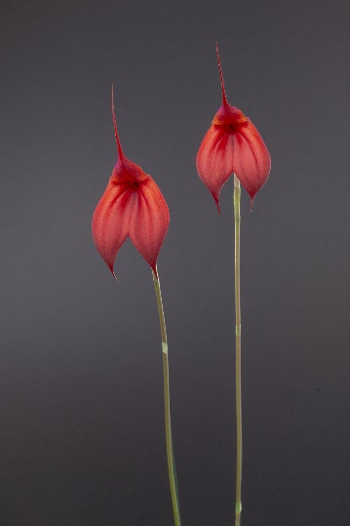
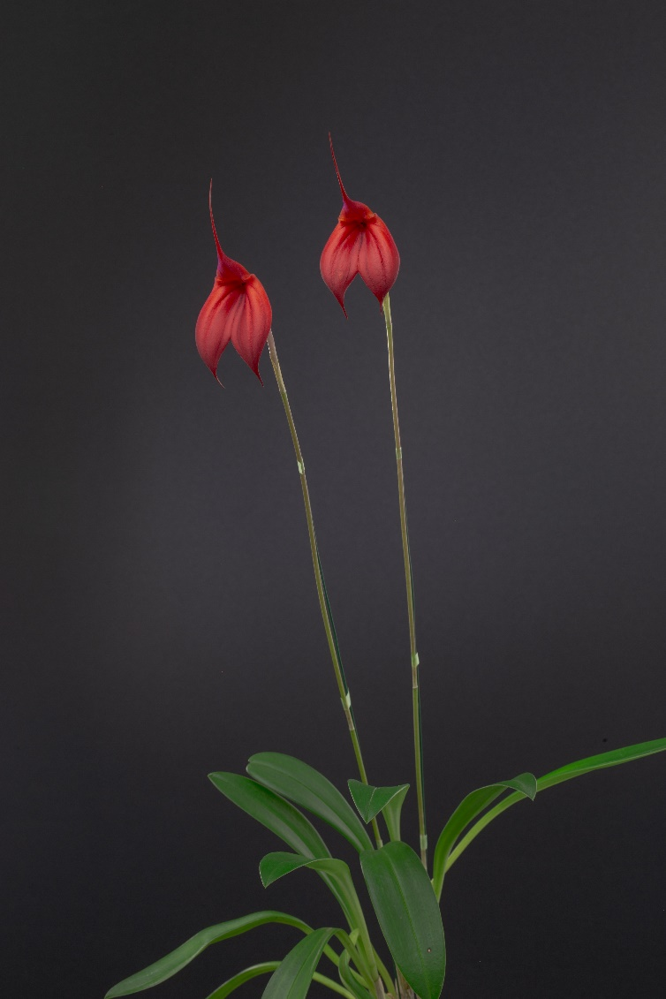
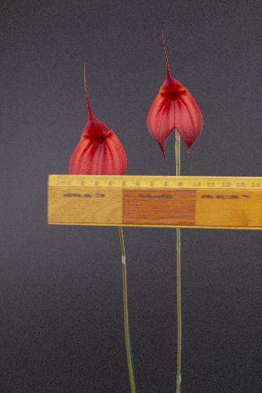
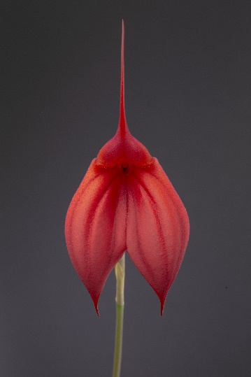
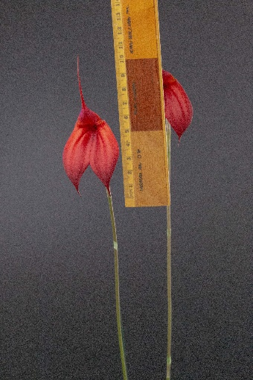
An example of the photos provided for an award candidate Masdevallia Heartlight ‘Crown Vista’

Slide 4
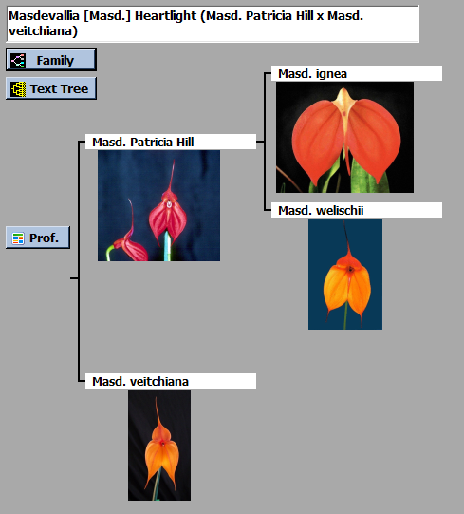
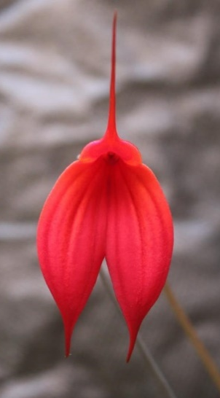
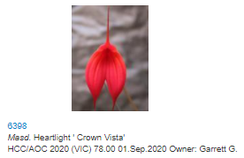
‘Phone’ judging allowed more research to be undertaken – for example, on OrchidWiz and from other Panels

Slide 5
The 4 most recent overall vooty winners

Slide 6
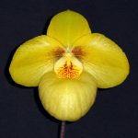
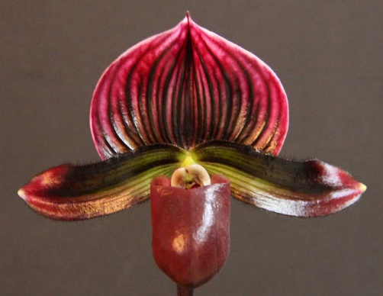
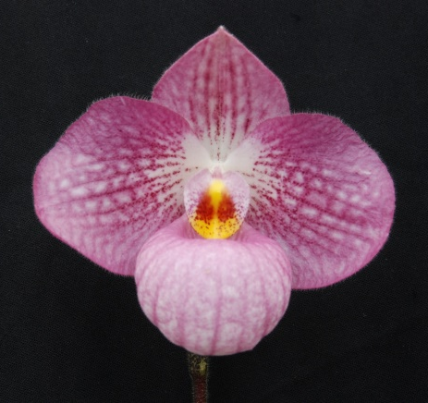
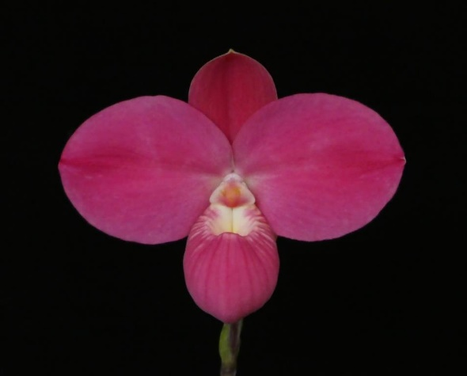
2018
Paph. Golden Goblet ‘Brian’ – M. J. Coker
2019
Paph. Peppercorn ‘Alexandra’ – M. J. Coker
2020
Paph. Puffy ‘Quatro’ – Marilyn & Barry Larkin
2021
Phrag. Fritz Schomburg ‘Everest’ – M. J Coker

Slide 7
Mem. Chris Waterman AUSTRALIAN NATIVE
HYBRID ORCHID
Sponsored by
Mornington Peninsula Orchid Society

Slide 8
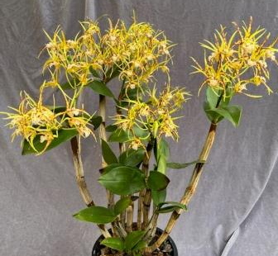
Den. Stoney Point ‘Janine’
Daryl Mills
HCC/OSCOV
78.3
Notes:
8

Slide 9
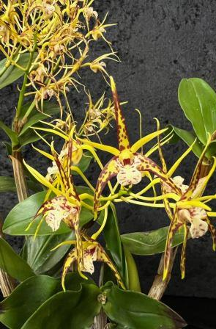
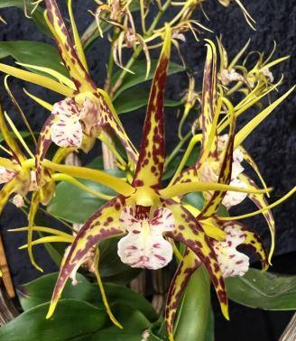
Notes:
9

Slide 10
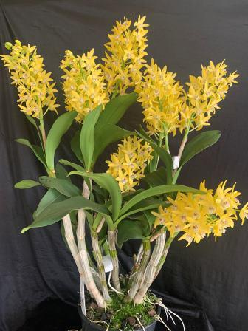
Den. Brimbank Dream ‘Journey’
Hao Nam
AM/OSCOV
81.0
Notes:
10

Slide 11
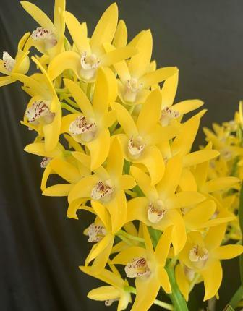
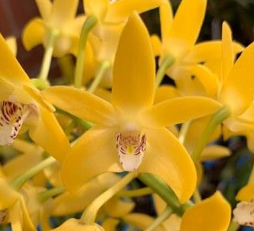
Notes:
11

Slide 12
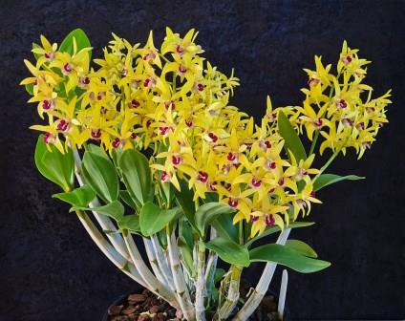
Den. Ray’s Quest ‘Excelsior’
Ray Gribble
AM/OSCOV
80.0
Notes:
12

Slide 13
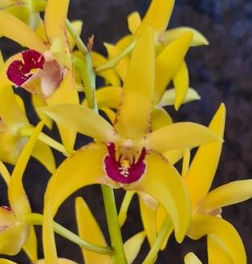
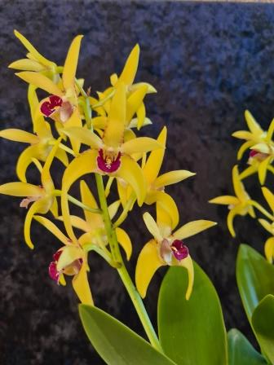
Notes:
13

Slide 14
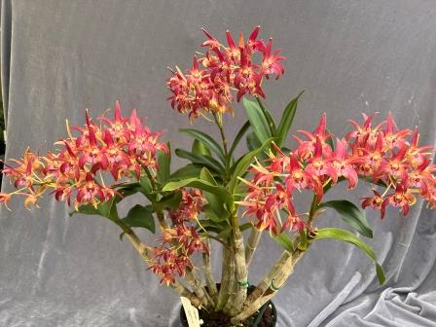
Den. Brimbank Fire ‘Flame’
Marita Anderson
AM/OSCOV
81.1
Notes:
14

Slide 15
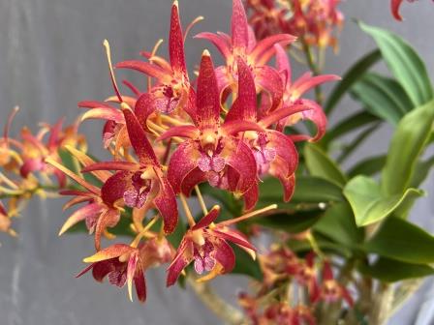
Notes:
15

Slide 16
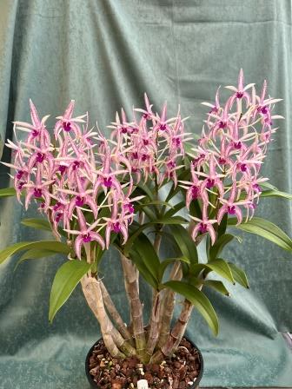
Den. Cosmic Opal ‘Nebula’
Marita Anderson
AM/OSCOV
81.4
Notes:
16

Slide 17
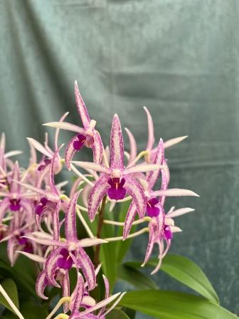
Notes:
17

Slide 18
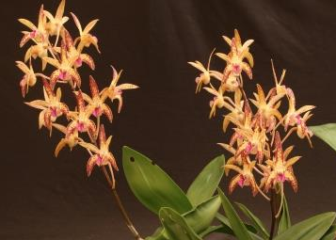
Den. Sunset Gold ‘Berry’
Marita Anderson
HCC/OSCOV
78.0
Notes:
18

Slide 19
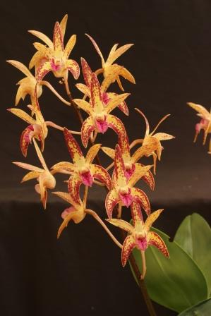
Notes:
19

Slide 20
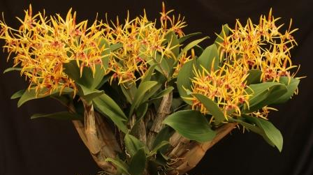
Den. Essie Banks ‘Diadems’
Marita Anderson
HCC/OSCOV
77.8
Notes:
20

Slide 21
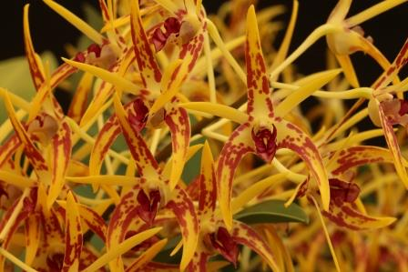
Notes:
21

Slide 22
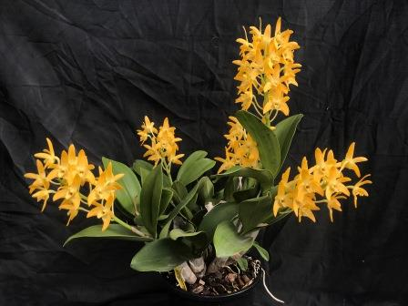
Den. Carrajung ‘Rebel’
Chris Pegg
AM/OSCOV
81.3
Notes:
22

Slide 23
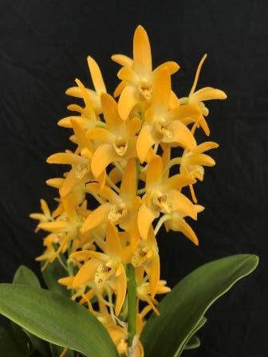
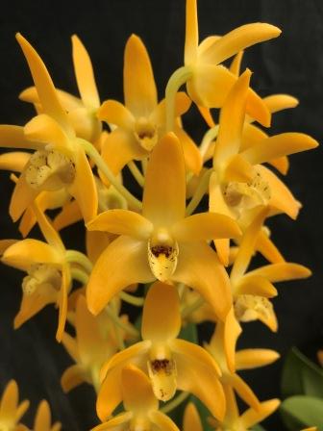
Notes:
23

Slide 24
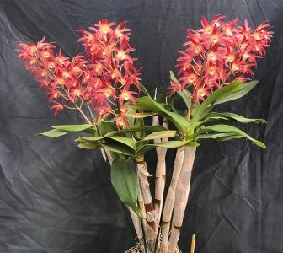
Den. Australian Sheemamere ‘Firecracker’
Chris Pegg
AM/OSCOV
83.1
Notes:
24

Slide 25
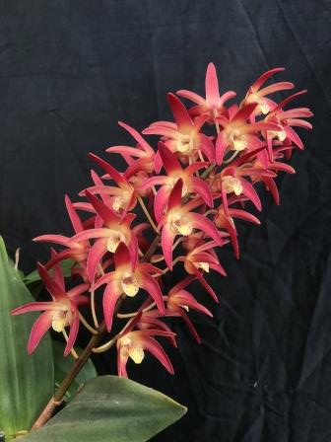
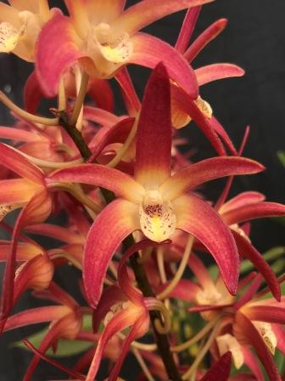
Notes:
25

Slide 26
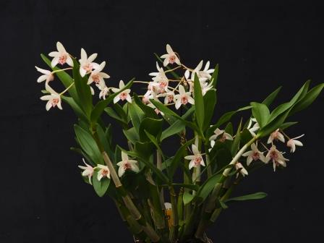
Den. Wayne Turville ‘Crystal’
Murray Harding & Di Lester
HCC/OSCOV
76.3
Notes:
26

Slide 27
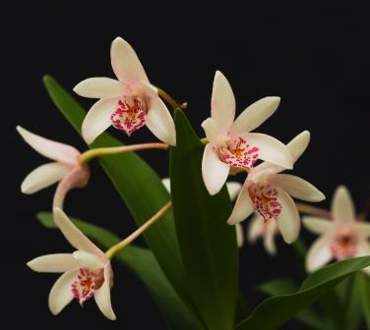
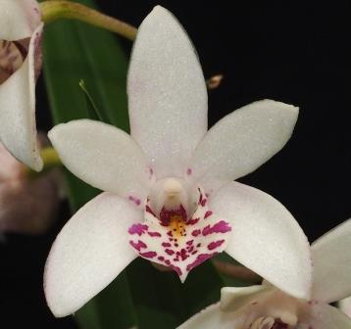
Notes:
27

Slide 28
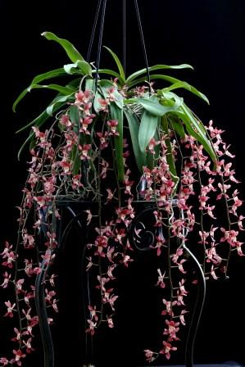
Sarcochilus Otway’s Robin ‘Serendipity’ – Sylvia Kappl
HCC/OSCOV
76.5
Notes:
28

Slide 29
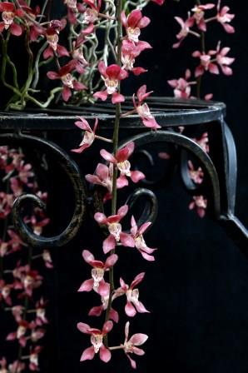
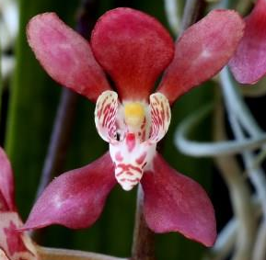
Notes:
29

Slide 30
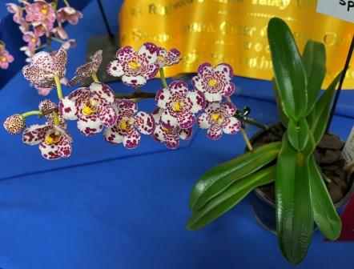
Sarco. Glenda ‘Special’
Clive & Agi Halls
HCC/OSCOV
79.3
Notes:
30

Slide 31
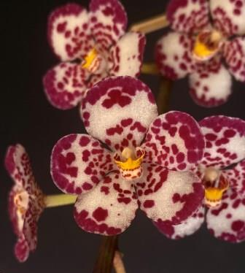
Notes:
31

Slide 32
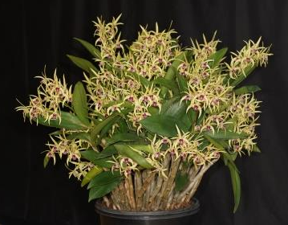
Den. Aussie Starlight ‘Kangaroo Lake’
G. & L. Shrubsole
HCC/OSCOV
76.8
Notes:
32

Slide 33
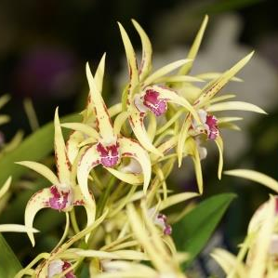
Notes:
33

Slide 34
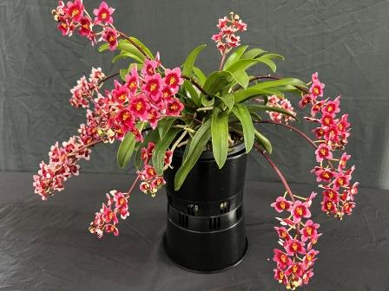
Sarco. Magic ‘Sharyn’
Sharyn Bolitho
HCC/OSCOV
79.2
Notes:
34

Slide 35
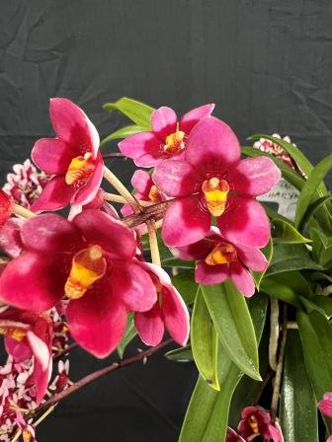
Notes:
35

Slide 36
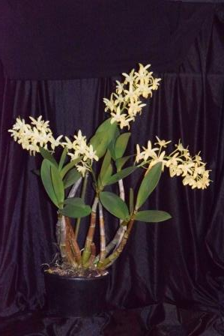
Den. Yarra Glen ‘Exuberance’
Peter Adams & Sheryl Lawson
HCC/OSCOV
77.1
Notes:
36

Slide 37
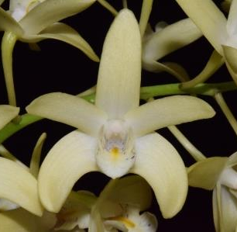
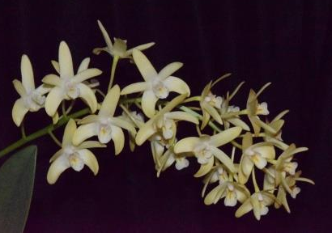
Notes:
37

Slide 38
AND THE WINNER is . . .

Slide 39
Den. Brimbank Dream ‘Journey’
Hao Nam
Notes:
39

Slide 40
AUSTRALIAN NATIVE
Species ORCHID
Sponsored by
Yarra Valley Orchid Society

Slide 41
Den. tetragonum ‘Shoalhaven’
M. J. Coker

Slide 43
Sarco. ceciliae ‘Anna’
Victor & Anna Helbig
HCC/OSCOV
78.8

Slide 45
Dendrobium speciosum ‘Palmerston Mist Ted’
Chris Pegg
AM/OSCOV
83.9

Slide 47
Den. jonesii ‘Vuong’
Vuong Dang
HCC/OSCOV
78.2

Slide 49
Cym. canaliculatum ‘Daphne’
Chris Pegg
HCC/OSCOV
77.5

Slide 51
Den. kingianum ‘Jacques Miller’
Peter Adams & Sheryl Lawson
HCC/OSCOV
77.9

Slide 53
AND THE WINNER IS . . .

Slide 54
Cym. canaliculatum ‘Daphne’
Chris Pegg

Slide 55
cymbidium hybrid ORCHID
Sponsored by the
Cymbidium Society of Victoria

Slide 56
Cymbidium Laramie Joy ‘Tall Gold’
Terry Poulton

Slide 58
Cym. Laramie Winter ‘Mango Lip’ – Terry Poulton

Slide 60
Cym. Laramie Eagle ‘TeePee’ – Terry Poulton

Slide 62
Cym. Barrita ‘Trinket’ Terry Poulton

Slide 64
Cym. Laramie Blaze ‘TeePee’ – Terry Poulton

Slide 66
Cym. Little Beauty ‘RACB’
Robin Bavinton
HCC/OSCOV
77.4

Slide 68
AND THE WINNER IS . . .

Slide 69
Cym. Laramie Blaze ‘TeePee’ – Terry Poulton

Slide 70
Laeliinae hybrid ORCHID
Sponsored by
OSCOV

Slide 71
Cattleya Dolosa ‘Madonna’
M. J. Coker

Slide 72
Cattleya Aloha Case ‘Ching Hua’
M. J. Coker

Slide 73
Cattleya Tokyo Magic ‘Shinkansen’ – M. J. Coker
HCC/OSCOV
78.1

Slide 74
AND THE WINNER IS . . .

Slide 75
Cattleya Dolosa ‘Madonna’
M. J. Coker

Slide 76
Masdevallia hybrid ORCHID
Sponsored by
Warrnambool & District Orchid Society

Slide 77
Masd. Curacao ‘Hamish’ Nick Shaw

Slide 79
Masd. Harlequin Dancer ‘Pierrot’
Marita Anderson
HCC/OSCOV
77.7

Slide 81
Masd. Harlequin Dancer ‘Colombine’
Marita Anderson
HCC/OSCOV
78.3

Slide 83
Masd. Flaming Flamingo ‘Beenak’
Clive & Agi Halls
HCC/OSCOV
79.9

Slide 85
Masd. Mem. Chris Waterman ‘Spectacular’
Clive & Agi Halls
HCC/OSCOV
79.9

Slide 87
AND THE WINNER IS . . .

Slide 88
Masd. Flaming Flamingo ‘Beenak’
Clive & Agi Halls

Slide 89
paphiopedilum hybrid ORCHID
Sponsored by
Ballarat Orchid Society

Slide 90
Paph. Dollgoldi ‘Tigress’
M. J. Coker

Slide 92
Paph. Traveler ‘Frances’
M. J. Coker

Slide 93
Paph. Dollgoldi ‘Golddolly’
M. J. Coker
HCC/OSCOV
78.0

Slide 94
Paph. Millenium Thunder ‘Camoflage’ – M. J. Coker
AM/OSCOV
80.8

Slide 95
Paph. Mem. Margaret Nielson ‘Garry’ – Garry Nielson
HCC/OSCOV 75.4

Slide 96
AND THE WINNER IS . . .

Slide 97
Paph. Millenium Thunder ‘Camoflage’ – M. J. Coker

Slide 98
paphiopedilum species ORCHID
Sponsored by
Stawell Orchid Society

Slide 99
Paph. druryi ‘Serpent’ M. J. Coker

Slide 100
Paph. malipoense ‘Snicketty’ – M. J. Coker

Slide 101
Paph. hirsutissimum ‘Twister’ – M. J. Coker

Slide 102
AND THE WINNER IS . . .

Slide 103
Paph. malipoense ‘Snicketty’ – M. J. Coker

Slide 104
ONCIDIINAE hybrid ORCHID
Sponsored by
Bendigo Orchid Club

Slide 105
Miltonia Cogniauxiae ‘Bino’ Hanh Truong

Slide 106
Oncidium Bellbird Grove ‘Leanne’ – Dieter Weise
HCC/OSCOV
79.5

Slide 107
AND THE WINNER IS . . .

Slide 108
Oncidium Bellbird Grove ‘Leanne’ – Dieter Weise

Slide 109
Any other hybrid ORCHID
Sponsored by
North-East Melbourne Orchid Society

Slide 110
Neopabstopetalum Mem. Emily Edith Lyttle ‘Linda’ – Linda Bunning

Slide 112
Phrag. Fritz Schomburg ‘Scotty’ – M. J. Coker

Slide 113
Phrag. Fritz Schomburg ‘Kayboldum’ – M. J. Coker
AM/OSCOV
80.0

Slide 114
Angrcm. Mem. Mark Aldridge ‘Madison’ Gabor & Juliana Szep
AM/OSCOV
81.8

Slide 116
Phal. Sheena ‘Banyena’ Michael & Bernadette Matthews
HCC/OSCOV
79.6

Slide 118
Phal. Sogo Amar ‘Banyena’ Michael & Bernadette Matthews
HCC/OSCOV
77.2

Slide 120
Den. Starburst ‘H&R’ Hanh Truong
HCC/OSCOV
79.7

Slide 121
AND THE WINNER IS . . .

Slide 122
Phrag. Fritz Schomburg ‘Kayboldum’ – M. J. Coker

Slide 123
Any other species ORCHID
Sponsored by The Orchid Species Society of Victoria

Slide 124
Coel. hampelii ‘Teardrops’
M. J. Coker

Slide 126
Ros. williamsianum ‘Jason’
M. J. Coker

Slide 128
Stenorrhynchos
glicensteinii ‘Flares’
Dieter Weise
AM/OSCOV
80.1

Slide 129
Trichocentrum longicalcaratum ‘Banyena’
Michael & Bernadette Matthews
CBM/OSCOV

Slide 131
Habenaria medioflexa ‘Serpentine’ – M. J. Coker
CBM/OSCOV

Slide 133
Cattleya loddigesii ‘Lois’ G. & L. Shrubsole
HCC/OSCOV
78.8

Slide 135
Pterygodium catholicum ‘Bert’ – P. & L. Williams
CBM/OSCOV

Slide 137
AND THE WINNER IS . . .

Slide 138
Stenorrhynchos
glicensteinii ‘Flares’
Dieter Weise

Slide 139
Harold, Florence & Julian Coker Memorial Trophy SEEDLING ORCHID
Sponsored by
Frances & Michael Coker

Slide 140
Cattleya Tokyo Magic ‘Shinkansen’ – M. J. Coker

Slide 141
Paph. Millenium Thunder ‘Camoflage’ – M. J. Coker

Slide 142
Den. Ray’s Quest ‘Excelsior’
Ray Gribble
Notes:
142

Slide 143
Masd. Flaming Flamingo ‘Beenak’
Clive & Agi Halls

Slide 144
Den. Carrajung ‘Rebel’
Chris Pegg
Notes:
144

Slide 145
Sarco. Glenda ‘Special’
Clive & Agi Halls
Notes:
145

Slide 146
Cym. Little Beauty ‘RACB’
Robin Bavinton

Slide 147
Paph. Mem. Margaret Nielson ‘Garry’ – Garry Nielson

Slide 148
AND THE WINNER IS . . .

Slide 149
Sarco. Glenda ‘Special’
Clive & Agi Halls
Notes:
149

Slide 150
Best cultured hybrid ORCHID
Sponsored by Berwick Orchid Society

Slide 151
Paph. Dollgoldi ‘Tigress’
M. J. Coker

Slide 152
Cym. Barrita ‘Trinket’ Terry Poulton

Slide 153
Miltonia Cogniauxiae ‘Bino’ Hanh Truong
CC/OSCOV

Slide 154
Den. Stoney Point ‘Janine’
Daryl Mills
CC/OSCOV
Notes:
154

Slide 155
Den. Tania ‘Star’
Jeanne Dunn
CC/OSCOV
Notes:
155

Slide 156
Den. Australian Ginger ‘Dimos’ – Mary Morgan
CC/OSCOV
Notes:
156

Slide 157
Sarcochilus Otway’s Robin ‘Serendipity’ – Sylvia Kappl
CC/OSCOV
Notes:
157

Slide 158
Den. Starburst ‘H&R’ Hanh Truong
CC/OSCOV

Slide 159
Den. Aussie Starlight ‘Kangaroo Lake’
G. & L. Shrubsole
CC/OSCOV
Notes:
159

Slide 160
Sarco. Dorrigo
Jeanne Dunn
CC/OSCOV
Notes:
160

Slide 161
Coelogyne Jannine Banks ‘Snow White’ Stephen & Meryl Early
CC/OSCOV
Notes:
161

Slide 162
AND THE WINNER IS . . .

Slide 163
Den. Starburst ‘H&R’ Hanh Truong

Slide 164
Best cultured species ORCHID
Sponsored by Maroondah Orchid Society

Slide 165
Coel. hampelii ‘Teardrops’
M. J. Coker

Slide 166
Den. tetragonum ‘Shoalhaven’
M. J. Coker

Slide 167
Den. fleckeri ‘Murray’
Murray Harding & Di Lester

Slide 168
Ros. williamsianum ‘Jason’
M. J. Coker

Slide 169
Sarco. ceciliae ‘Anna’
Victor & Anna Helbig
CC/OSCOV

Slide 170
Maxillaria picta ‘Anna’
Karin Balogh
CC/OSCOV

Slide 171
Stenorrhynchos
glicensteinii ‘Flares’
Dieter Weise
CC/OSCOV

Slide 172
Den. teretifolium ‘JD 30’
Jeanne Dunn
CC/OSCOV

Slide 173
Masdevallia caesia ‘Julian’
M. J. Coker
CC/OSCOV

Slide 174
Serapias lingua ‘Jan’
Jan Newgreen
CC/OSCOV

Slide 175
Leptotes bicolor ‘Milligan’
M. J. Coker
CC/OSCOV

Slide 176
Den. striolatum ‘Yakyak’
Hanh Truong
CC/OSCOV

Slide 177
Den. jonesii ‘Vuong’
Vuong Dang
CC/OSCOV

Slide 178
Isabelia pulchella ‘Saskia’
Di Visser
CC/OSCOV

Slide 179
Cym. canaliculatum ‘Daphne’
Chris Pegg
CC/OSCOV

Slide 180
AND THE WINNER IS . . .

Slide 181
Leptotes bicolor ‘Milligan’
M. J. Coker

Slide 182
Memoria Gunter Haar best cultured ORCHID
Sponsored by
OSCOV

Slide 183
Den. Starburst ‘H&R’
Hanh Truong
Leptotes bicolor ‘Milligan’
M. J. Coker

Slide 184
AND THE WINNER IS . . .

Slide 185
Den. Starburst ‘H&R’ Hanh Truong

Slide 186
Award of quality
Sponsored by Ringwood Orchid Society

Slide 187
Masd. Harlequin Dancer Marita Anderson
HCC/OSCOV
AQ/OSCOV
HCC/OSCOV

Slide 188
Den. Sunset Gold Marita Anderson
HCC/OSCOV
AQ/OSCOV

Slide 189
Den. Wayne Turville Murray Harding & Di Lester
HCC/OSCOV
AQ/OSCOV

Slide 190
AND THE WINNER IS . . .

Slide 191
Masd. Harlequin Dancer Marita Anderson

Slide 192
Award of distinction
Sponsored by Werribee Orchid Club

Slide 193
Den. Brimbank Vegas ‘Nykayla’ – Daryl Mills
AD/OSCOV

Slide 194
Sarco. Bonanza ‘L.A.C. 11’ Anna Christesen
AD/OSCOV

Slide 195
Phal. Sheena ‘Banyena’ Michael & Bernadette Matthews
AD/OSCOV

Slide 196
AND THE WINNER IS . . .

Slide 197
Phal. Sheena ‘Banyena’ Michael & Bernadette Matthews

Slide 198
And The 10 finalists for the 2022 vooty are . . .

Slide 199
Australian Native Hybrid
Australian Native Species
Cymbidium Hybrid
Laeliinae Hybrid
Masdevallia Hybrid

Slide 200
Paphiopedilum Species
Paphiopedilum Hybrid
Oncidiinae Hybrid
Any Other Hybrid
Any Other Species

Slide 201
AND THE VOOTY 2022 WINNER IS . . .

Slide 202
Stenorrhynchos
glicensteinii ‘Flares’
Dieter Weise

Slide 203
The End !

