Slide 1
Oscov’s Victorian orchids of the year 2019

Slide 2
Mem. Chris Waterman AUSTRALIAN NATIVE
HYBRID ORCHID
Sponsored by
Mornington Peninsula Orchid Society

Slide 3
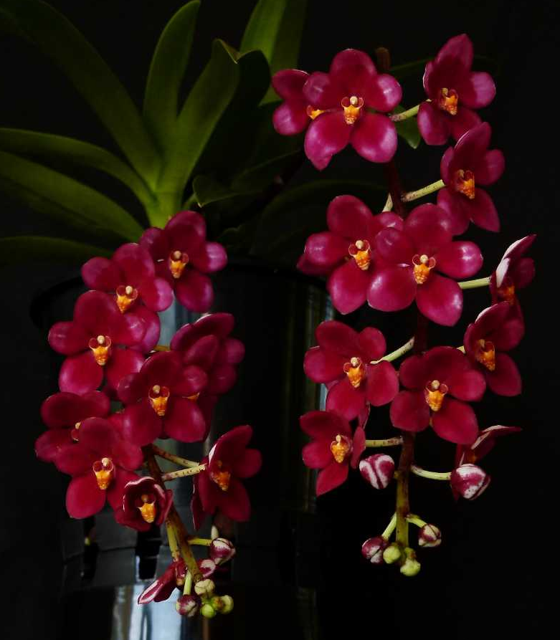
Sarcochilus Moonglow ‘Luxury’
Glenice Simmons
Notes:
3

Slide 4
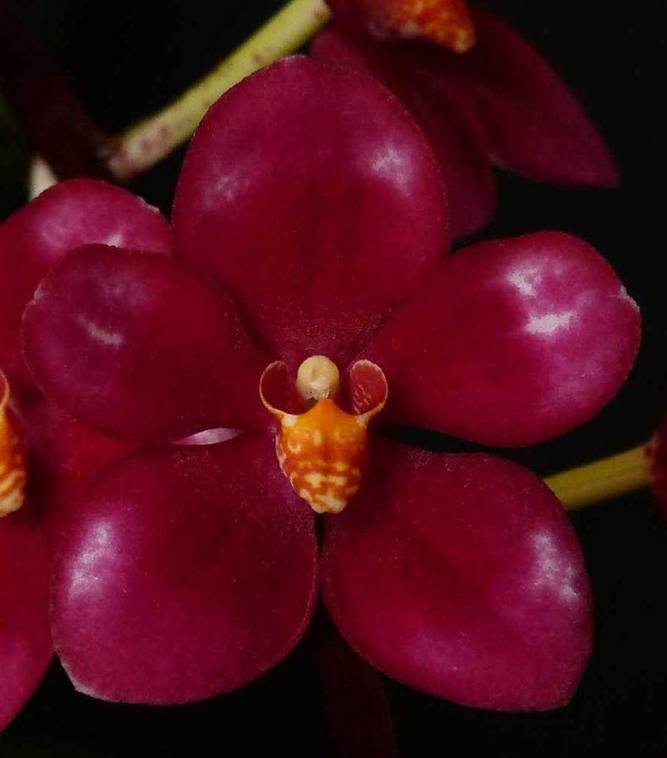

Slide 5
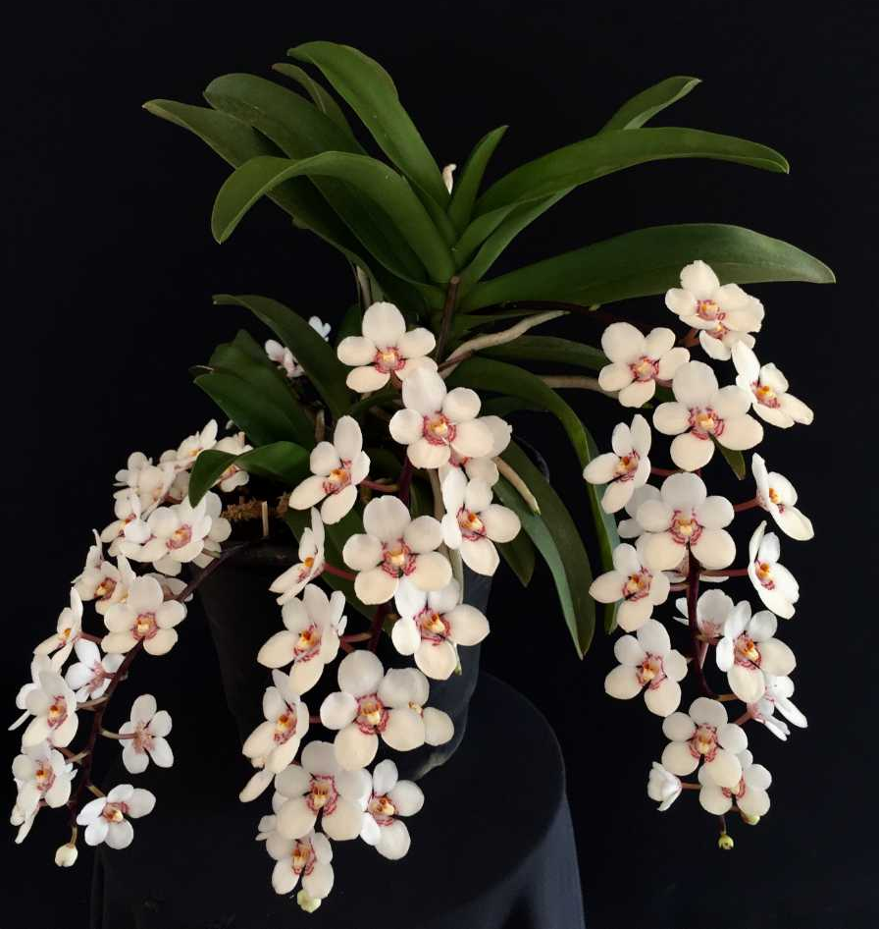
Sarcochilus Roy Gill ‘Beenak’
Clive & Agi Halls

Slide 6
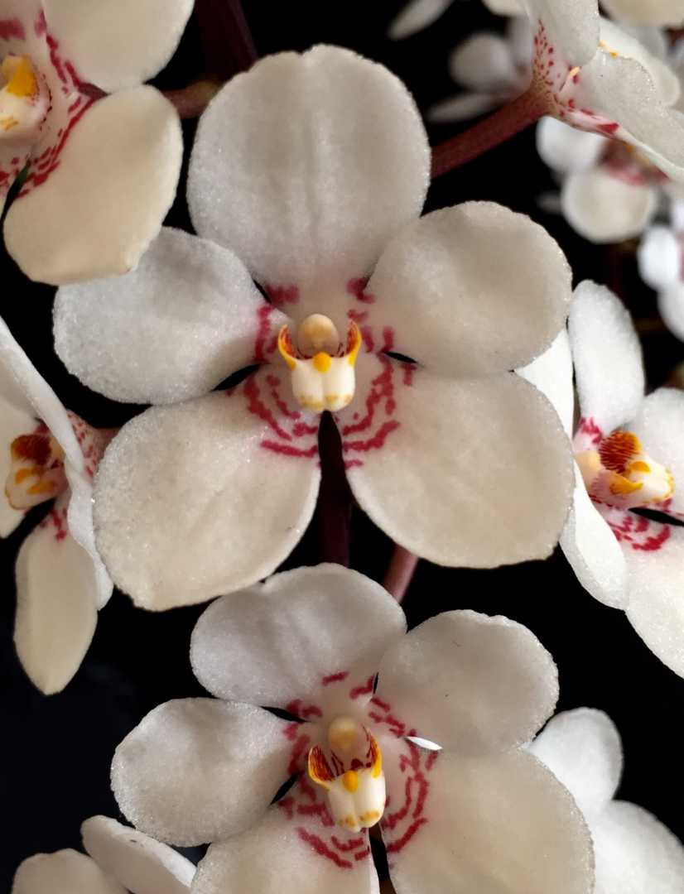

Slide 7
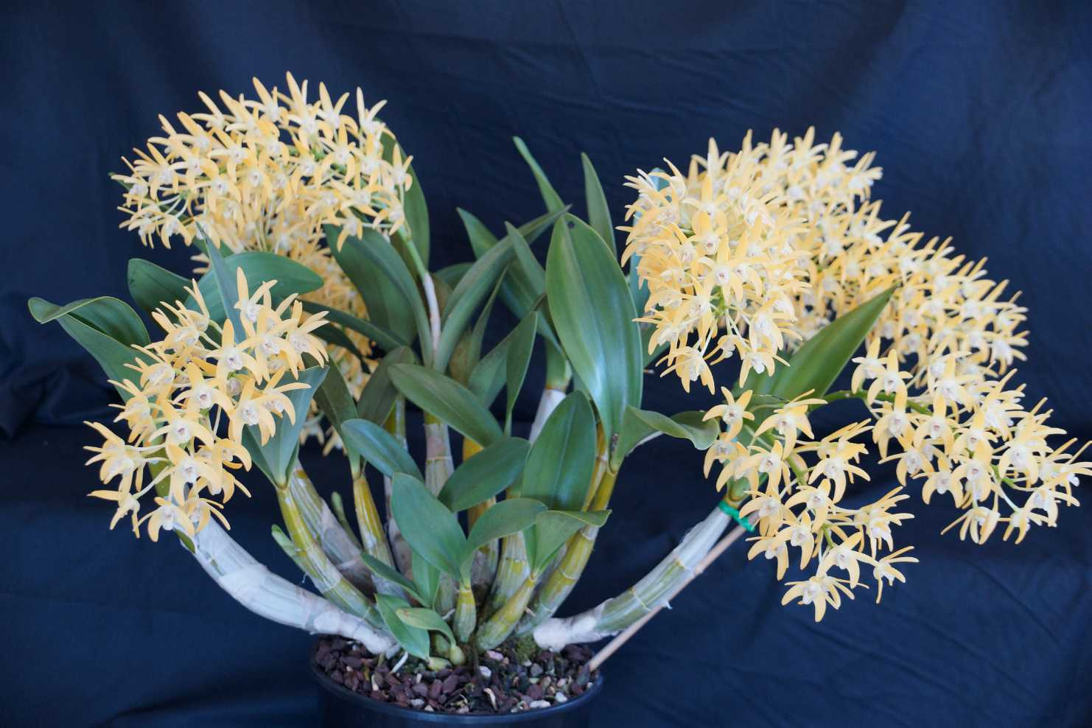
Dendrobium Australian Nugget ‘Pride of Australia’
Phil Grech
HCC/OSCOV
79.9

Slide 8
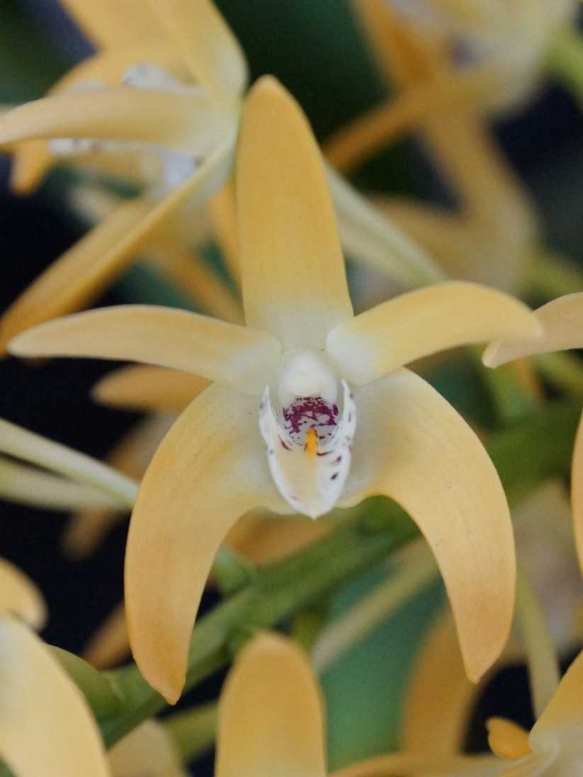

Slide 9
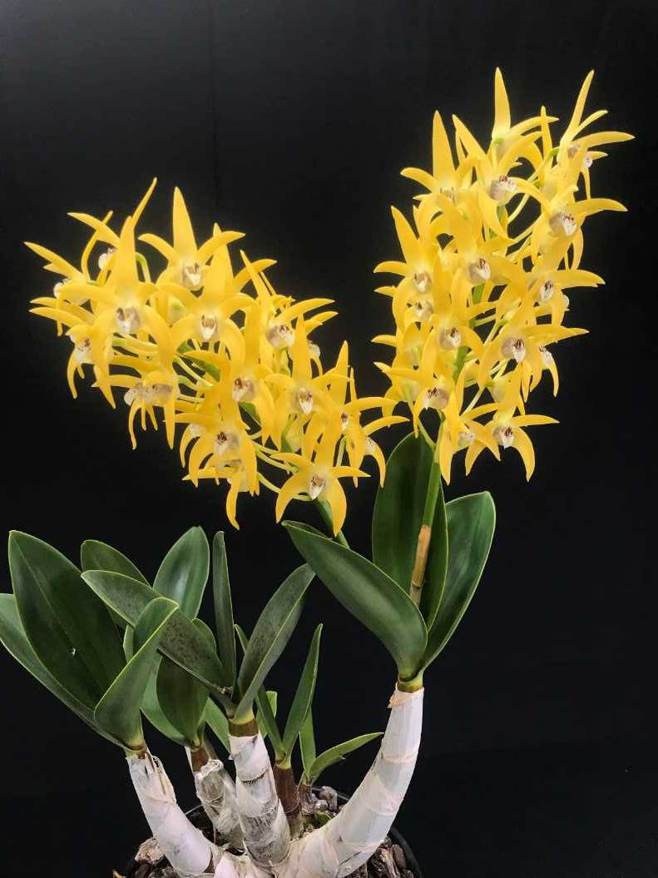
Dendrobium Cosmic Gold ‘Madison’
Chris Pegg
HCC/OSCOV
79.0
Notes:
9

Slide 10
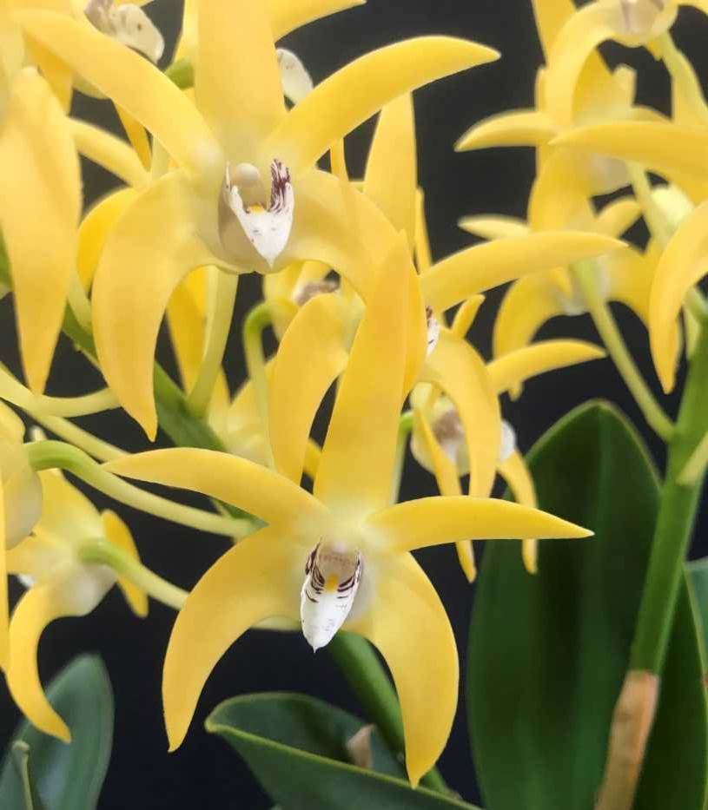

Slide 11
Dendrobium Hunter Titanium ‘Steroids’
Chris Pegg
AM/OSCOV
81.6

Slide 12
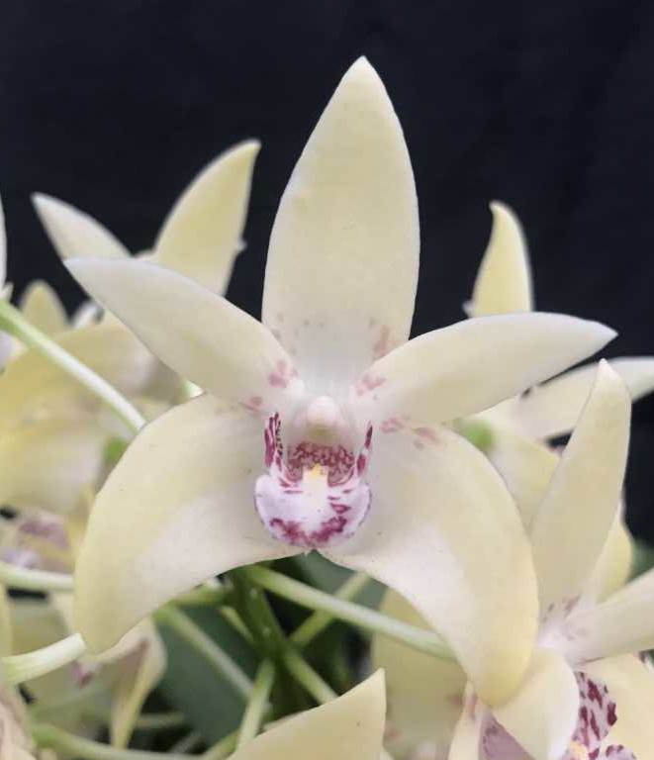

Slide 13
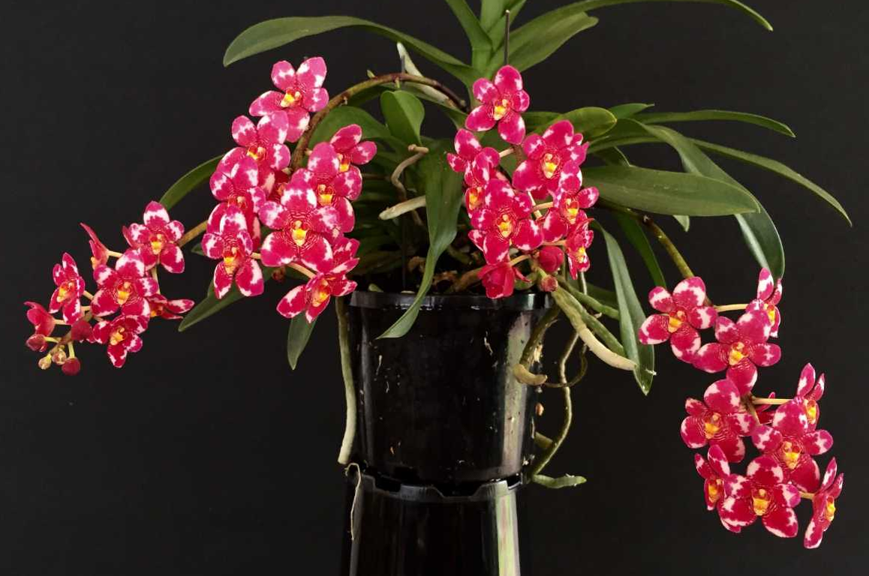
Sarcochilus Magic ‘Floral Circle’
Clive & Agi Halls
HCC/OSCOV
79.9

Slide 14
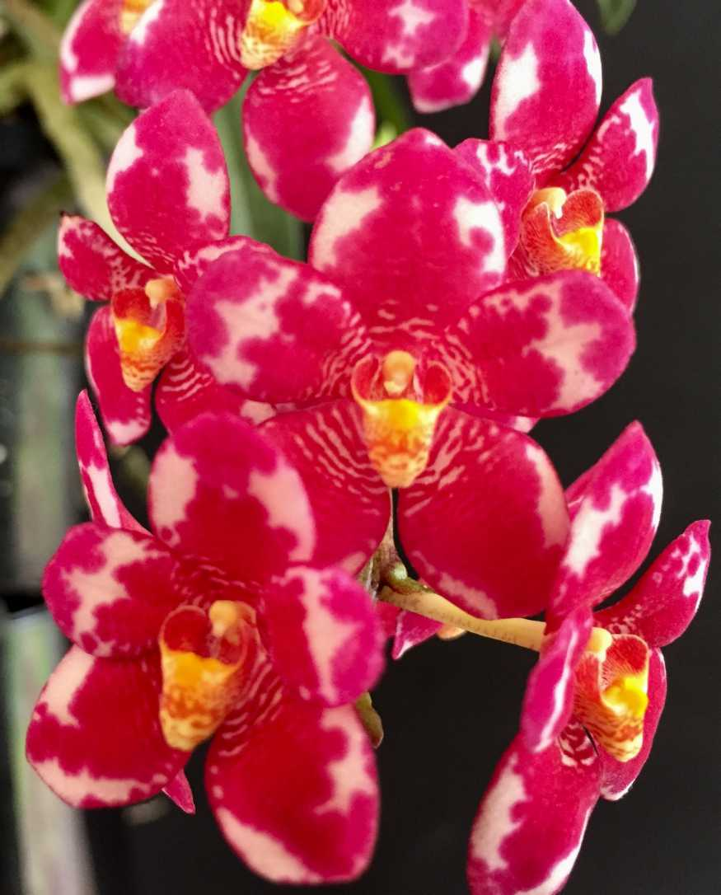

Slide 15
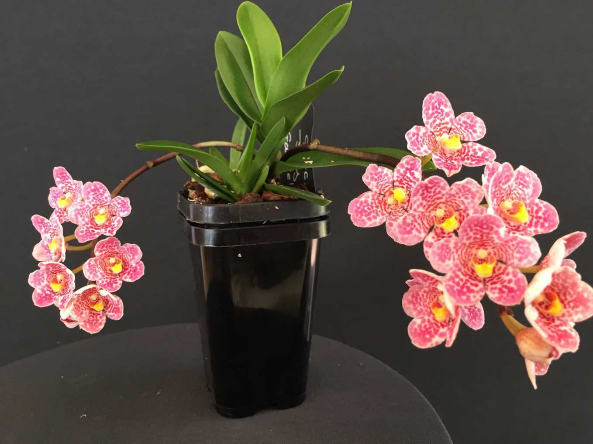
Sarcochilus Glenda ‘Beenak’
Clive & Agi Halls
HCC/OSCOV
77.5

Slide 16
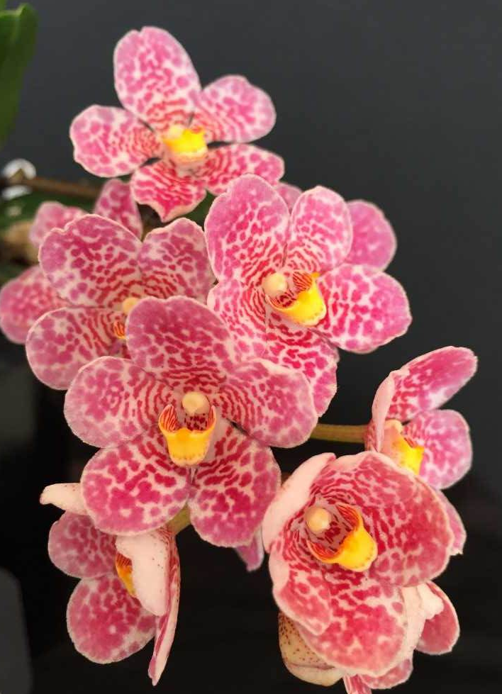

Slide 17
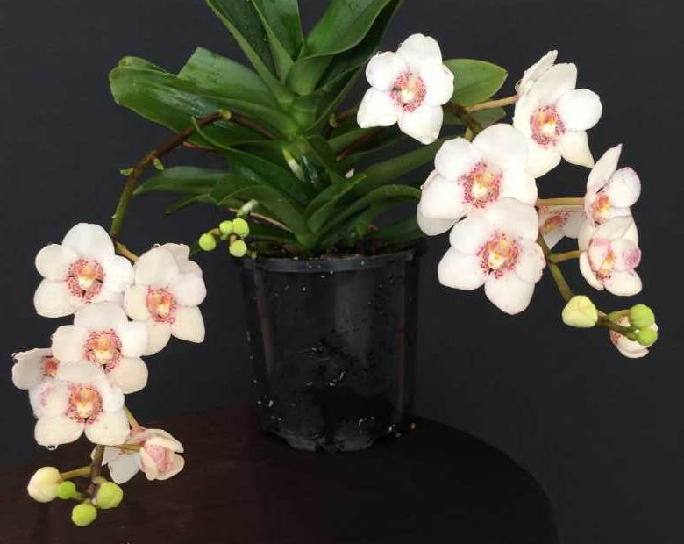
Sarcochilus Evelyn ‘Beenak’
Clive & Agi Halls
HCC/OSCOV
79.0

Slide 18
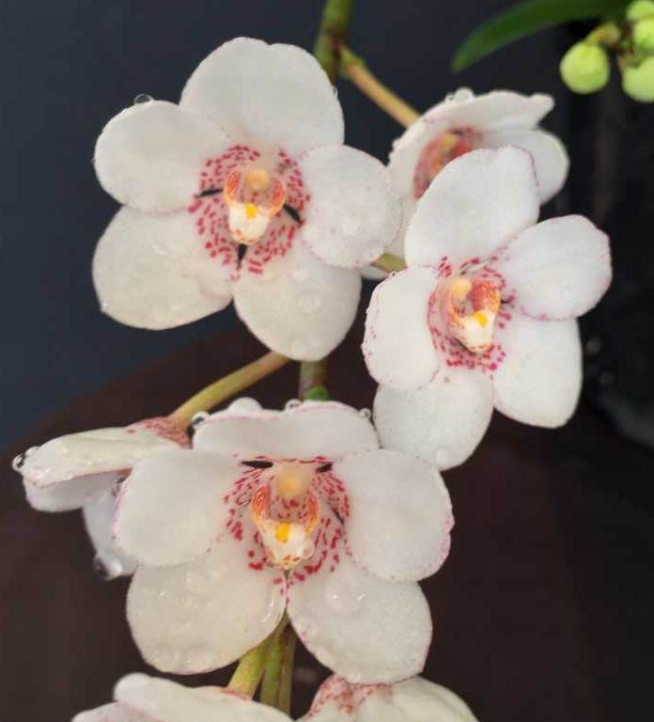

Slide 19
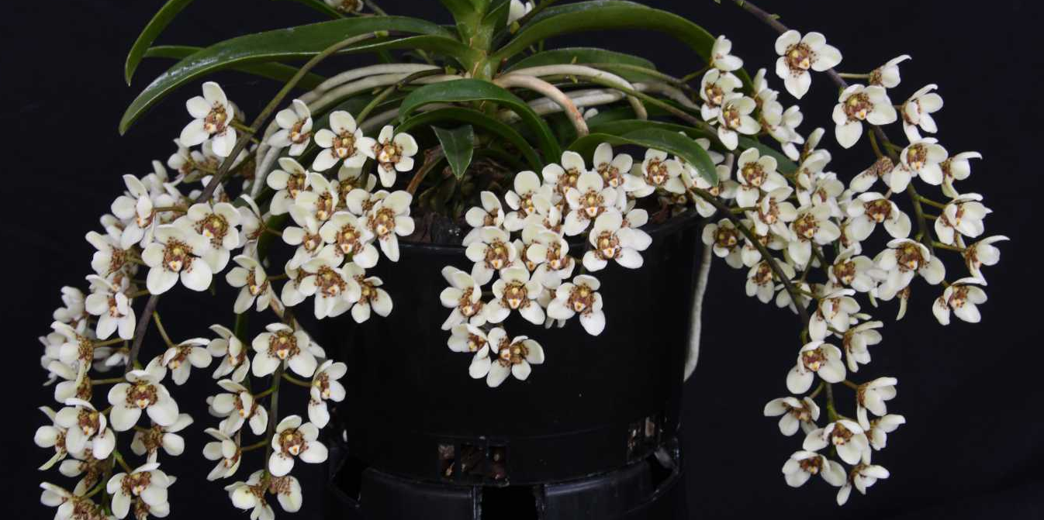
Sarcochilus Weinhart ‘Magic Wein’
V. & A. Helbig
HCC/OSCOV
76.5

Slide 20
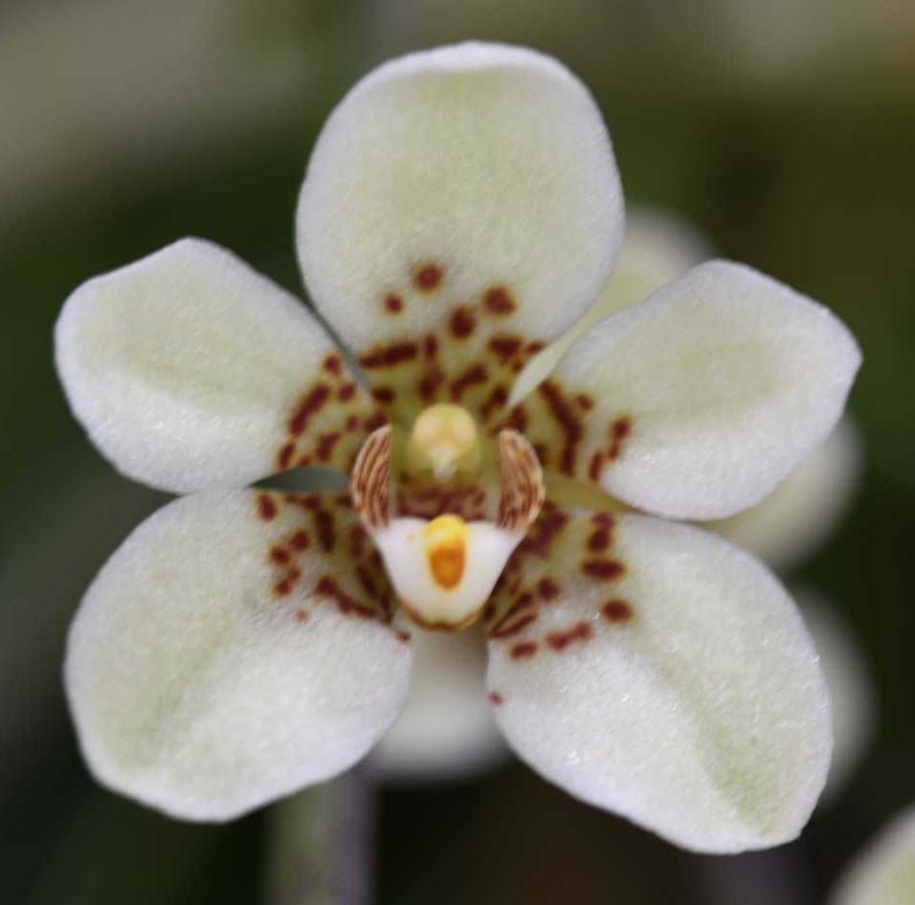

Slide 21
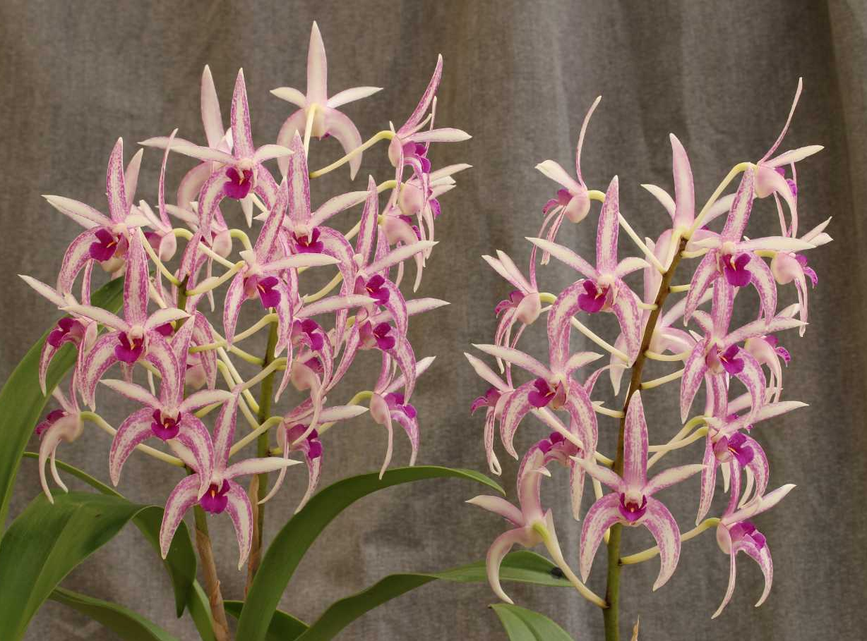
Dendrobium Cosmic Opal ‘Nebula’
Marita Anderson
HCC/OSCOV
79.5

Slide 22
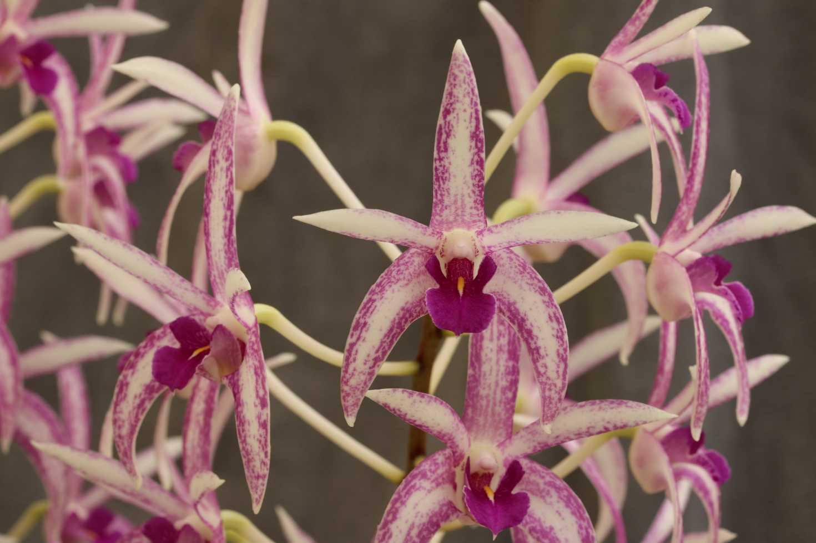

Slide 23
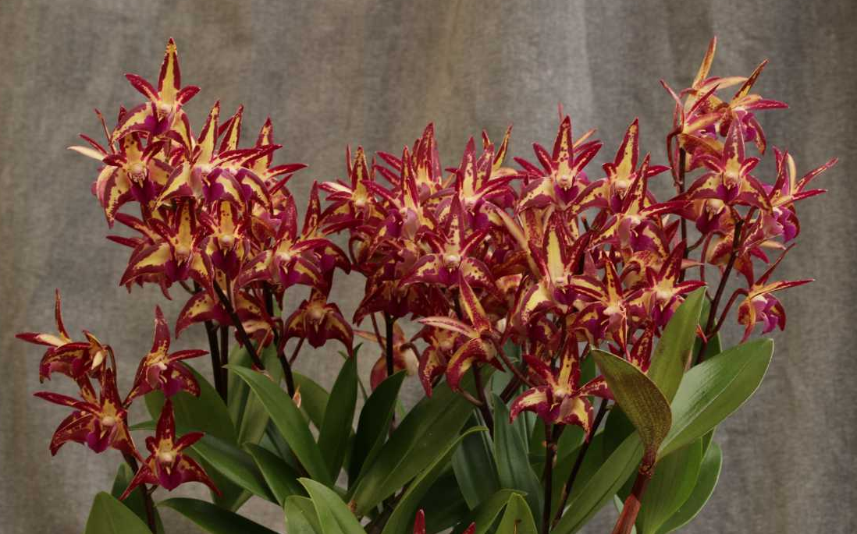
Dendrobium Brimbank Dark Night ‘Firedance’
Marita Anderson
HCC/OSCOV
76.8

Slide 24
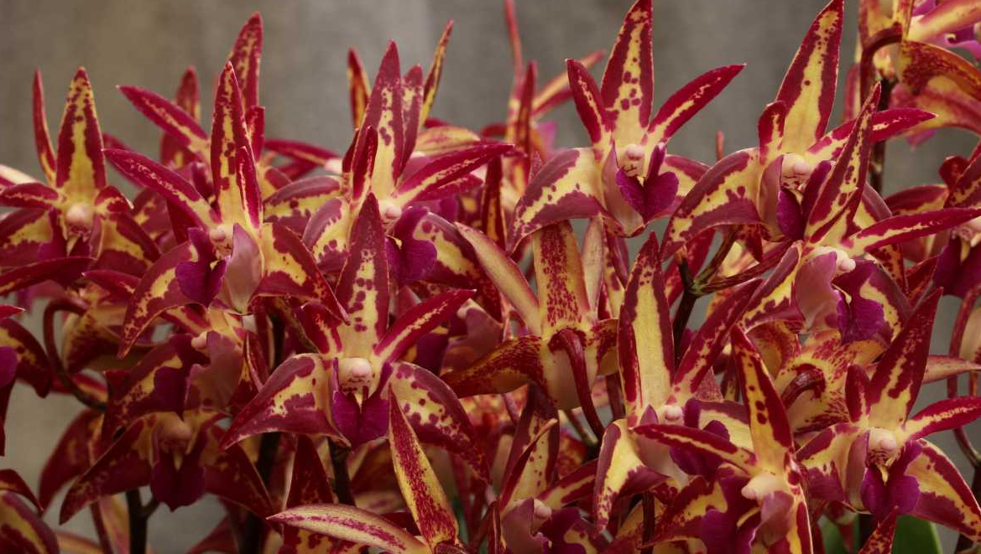

Slide 25
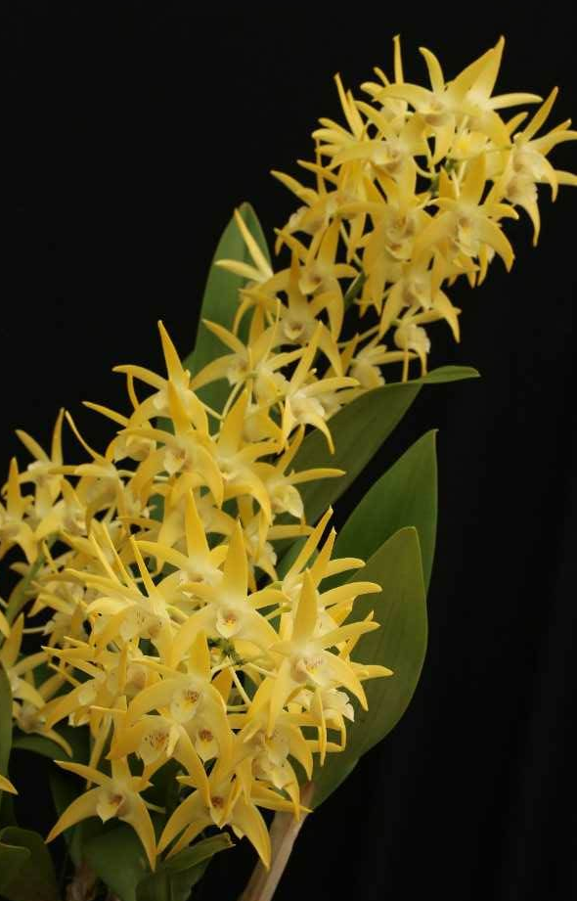
Dendrobium Brimbank Mikado ‘RACB’
Robin Bavinton
HCC/OSCOV
78.3

Slide 26
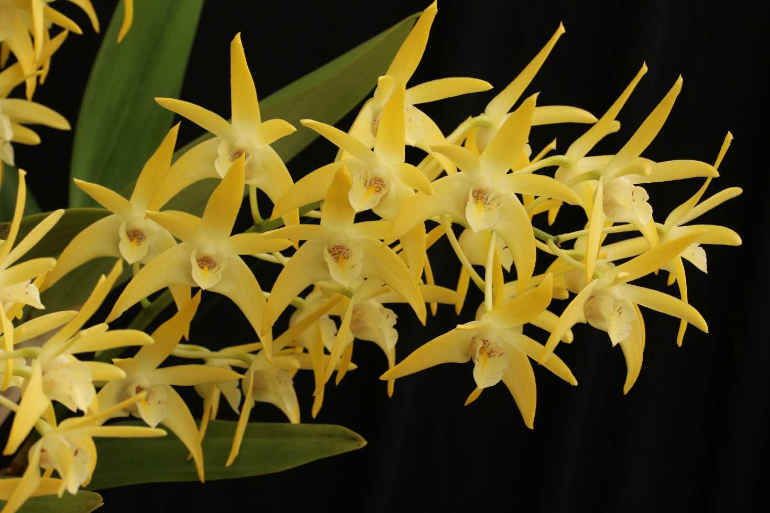

Slide 27
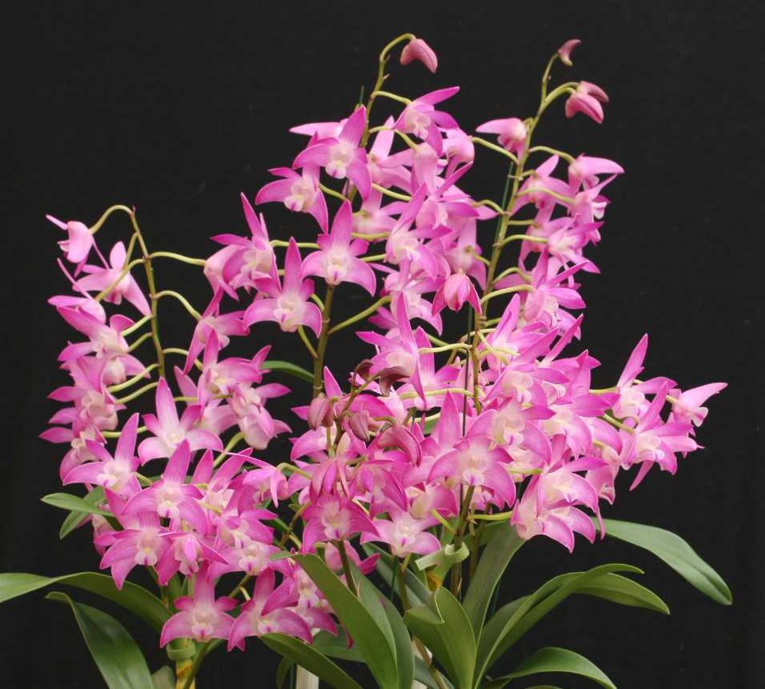
Dendrobium Florafest Indigo ‘RACB’
Robin Bavinton
HCC/OSCOV
79.3

Slide 28
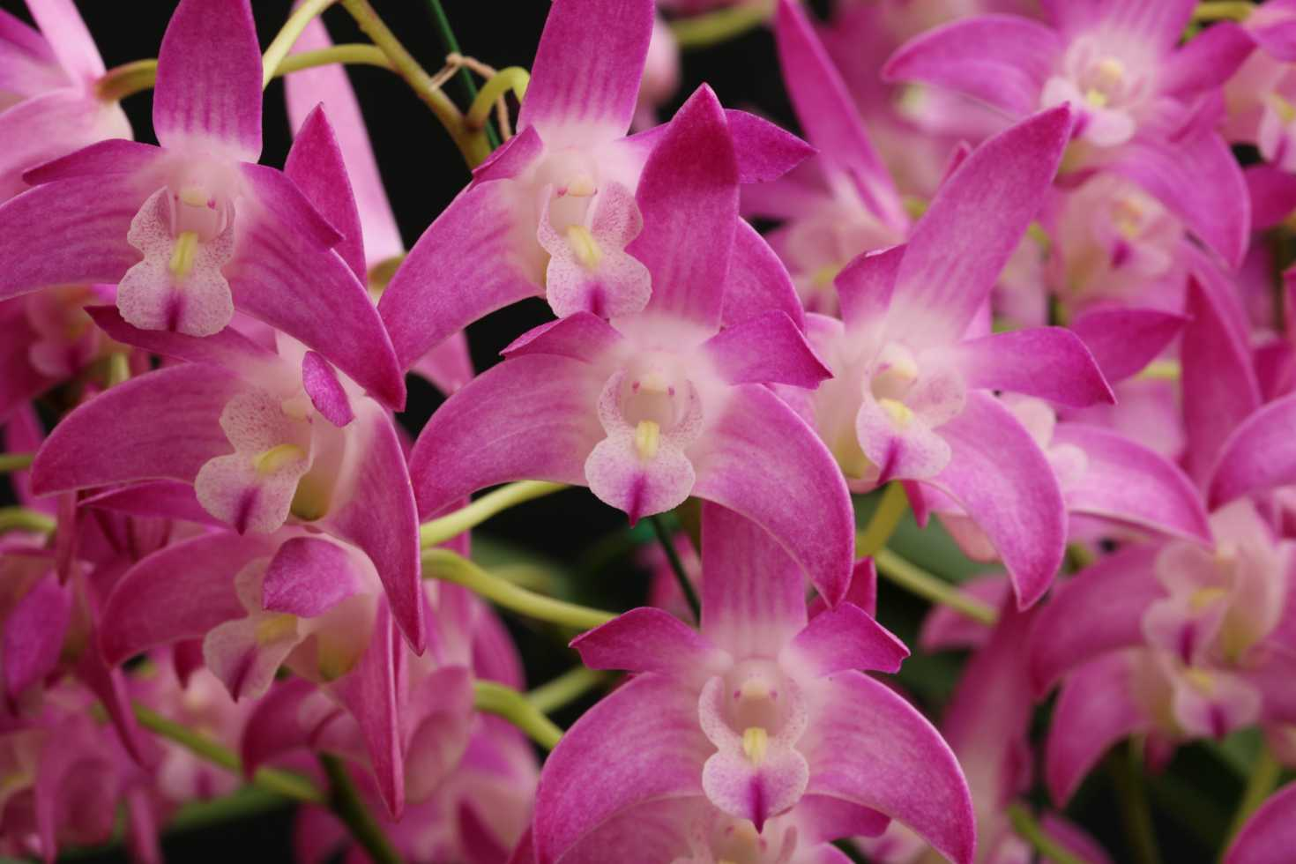

Slide 29
Dendrobium Currajung ‘RACB’
Robin Bavinton
HCC/OSCOV
78.2

Slide 30
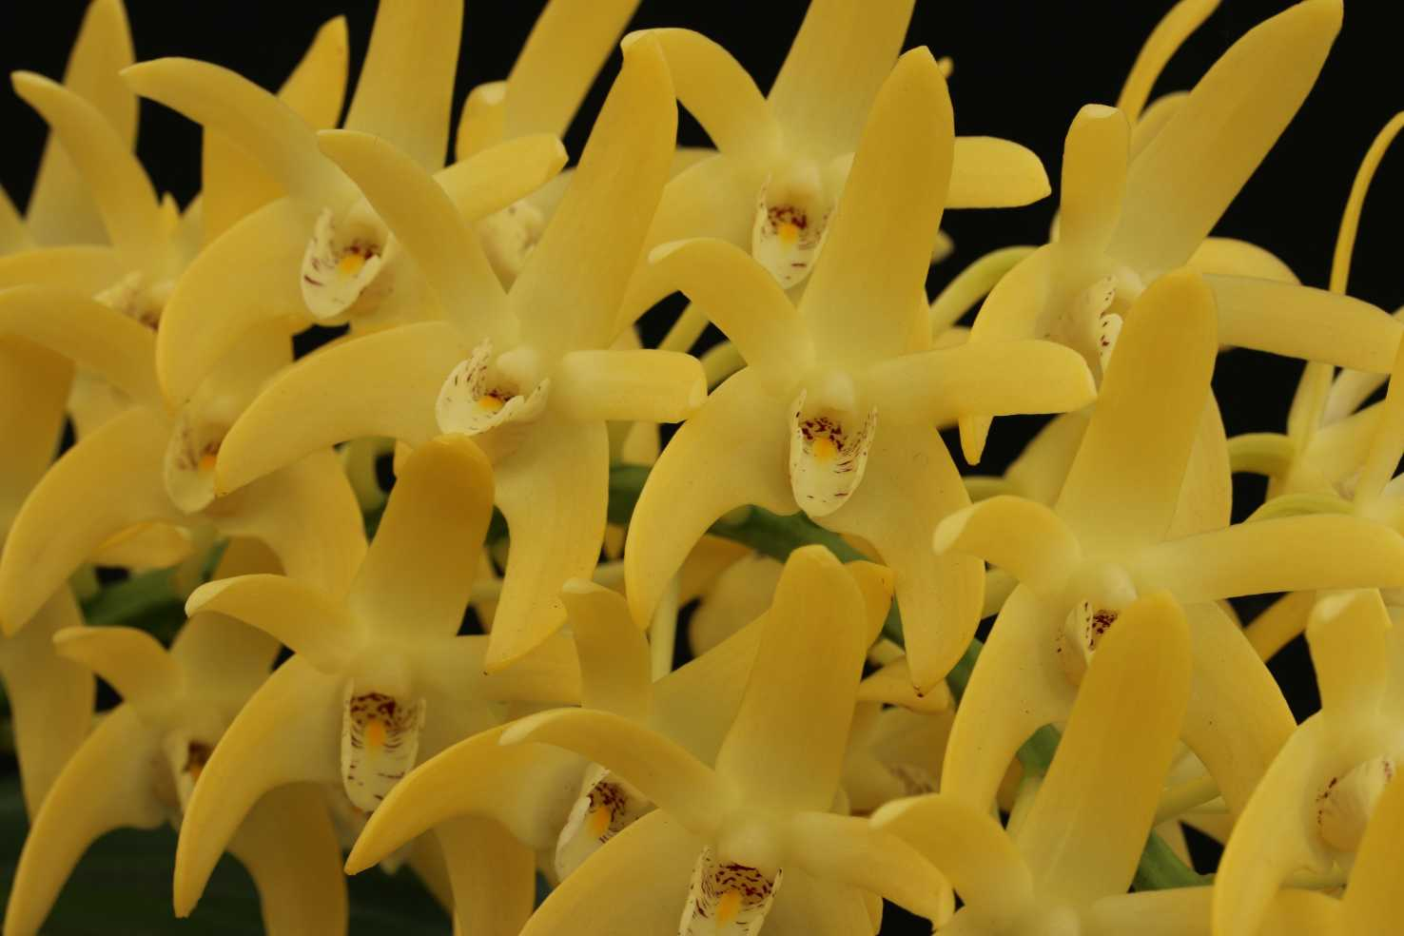

Slide 31
AND THE WINNERs ARE . . . !

Slide 32
Sarcochilus Moonglow ‘Luxury’
Glenice Simmons
Sarcochilus Roy Gill ‘Beenak’
Clive & Agi Halls

Slide 33
AUSTRALIAN NATIVE
Species ORCHID
Sponsored by
Yarra Valley Orchid Society

Slide 34
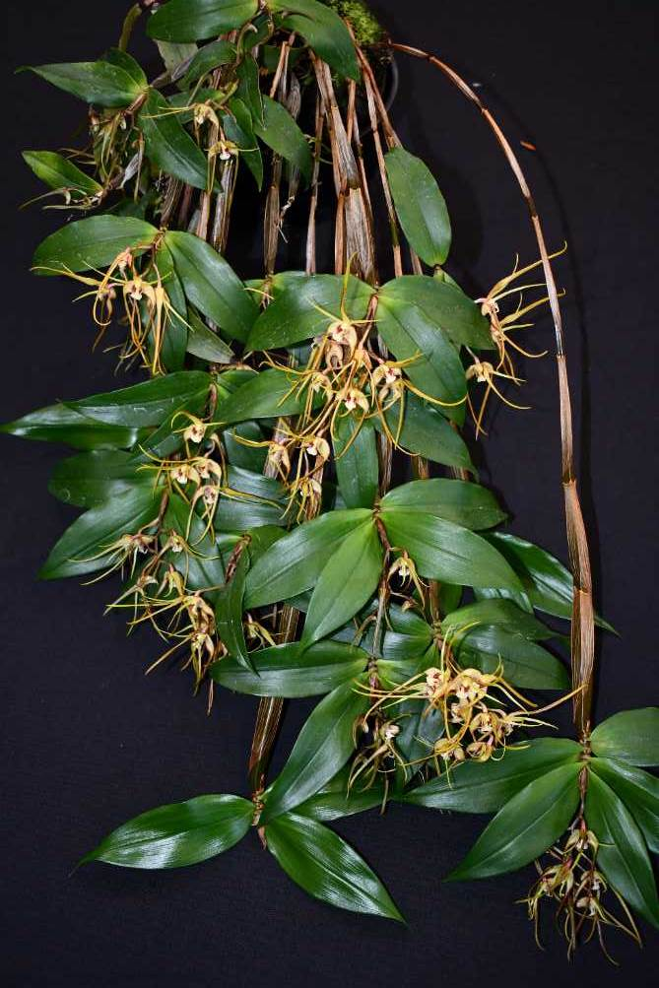
Dendrobium tetragonum ‘St. Austel’
Marilyn & Barry Larkin
HCC/OSCOV
75.0

Slide 35
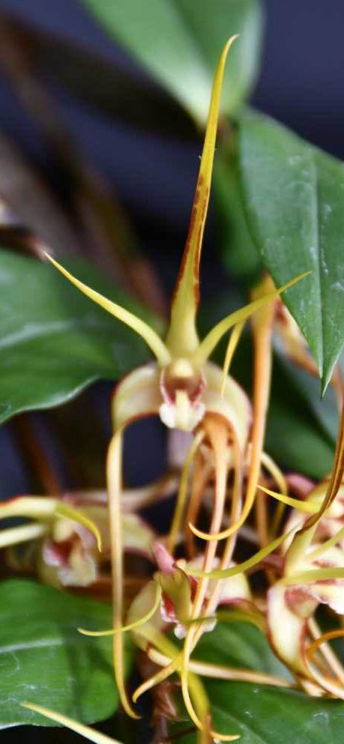

Slide 36
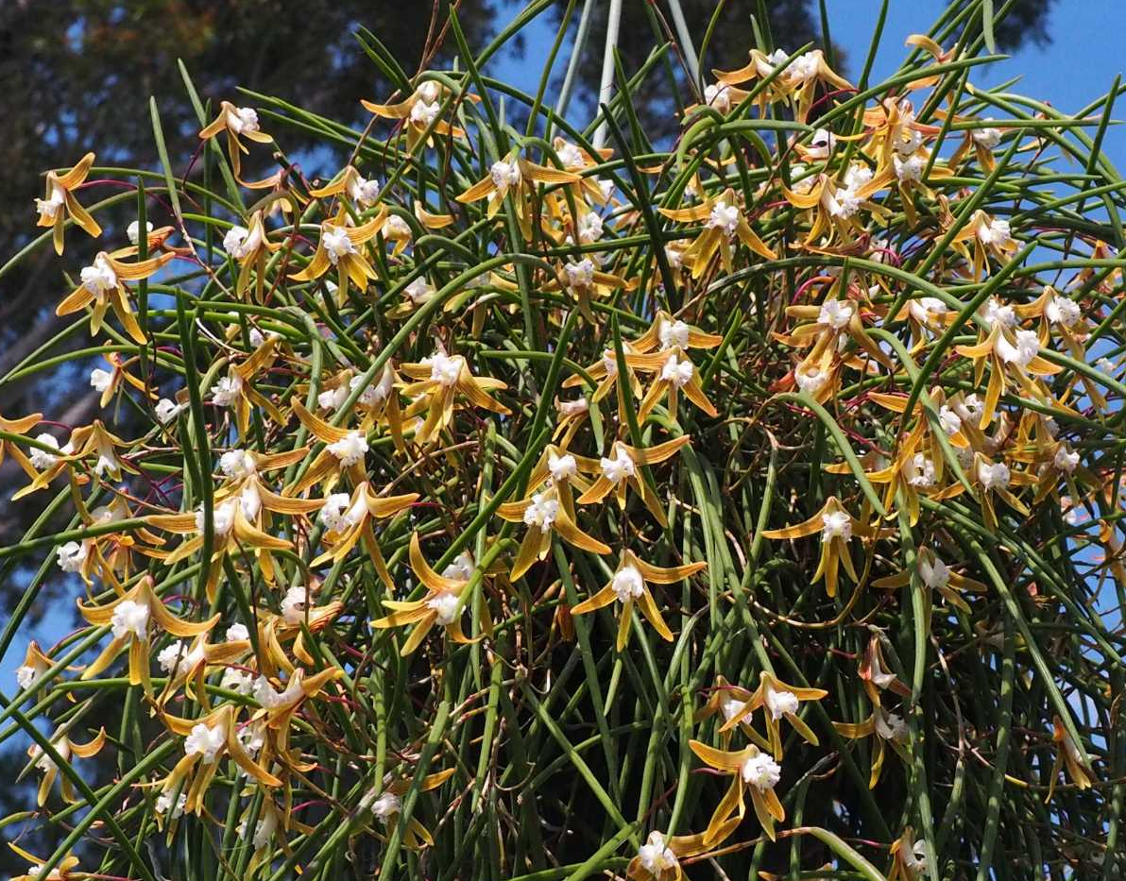
Dendrobium striolatum ‘Magic’
Murray Harding & Di Lester
HCC/OSCOV
77.0
Notes:
36

Slide 38
AND THE WINNER IS . . .

Slide 39
Dendrobium striolatum ‘Magic’
Murray Harding & Di Lester
Notes:
39

Slide 40
cymbidium hybrid ORCHID
Sponsored by the
Cymbidium Society of Victoria

Slide 41
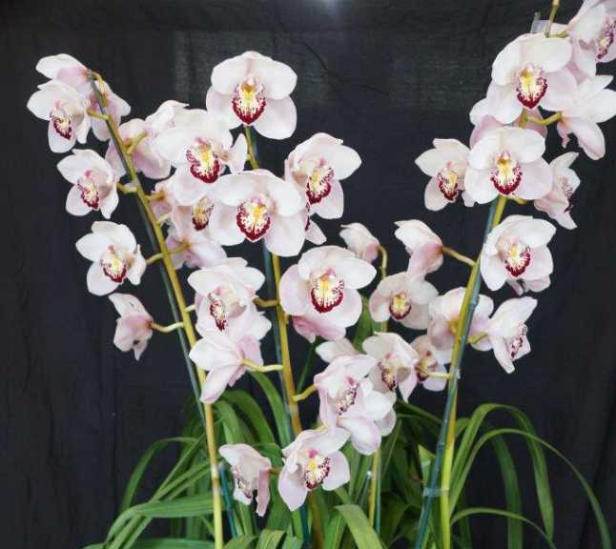
Cymbidium Kimberley Khan ‘Kentlyn’
Terry Poulton

Slide 42
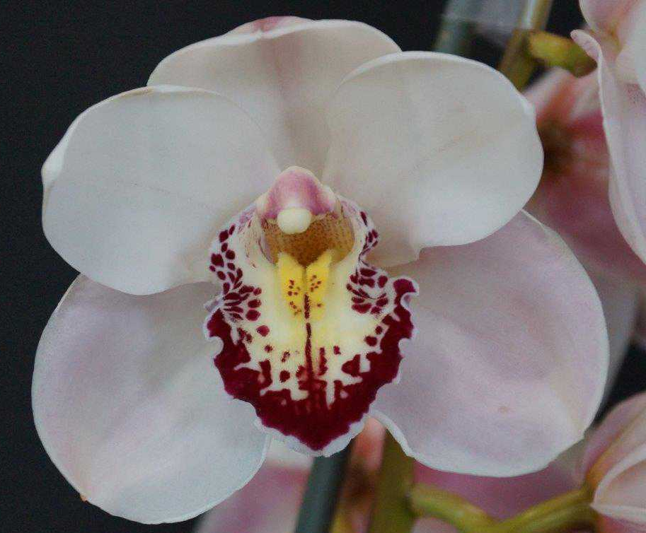

Slide 43
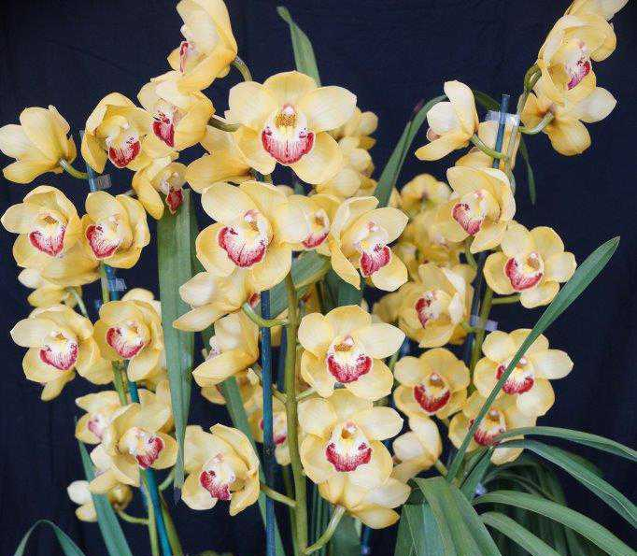
Cymbidium Laramie Gold ‘Golden Anniversary’
Terry Poulton

Slide 44
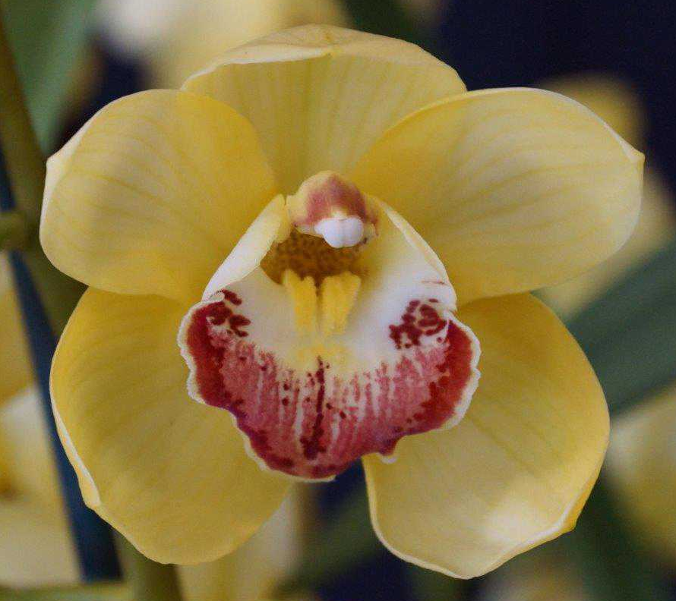

Slide 45
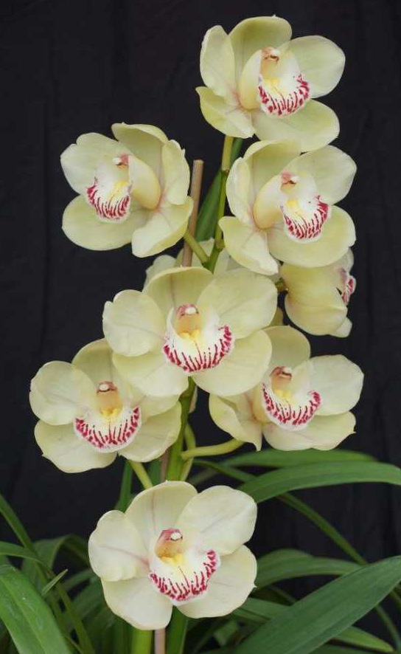
Cymbidium Laramie Lagoon ‘Tee Pee’
Terry Poulton

Slide 46
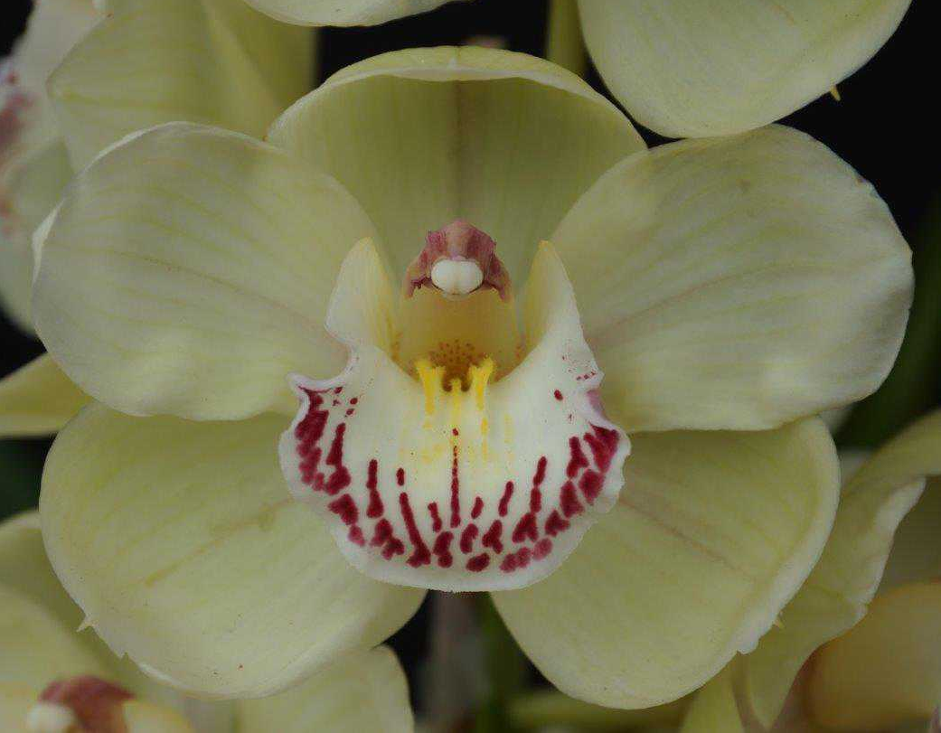

Slide 47
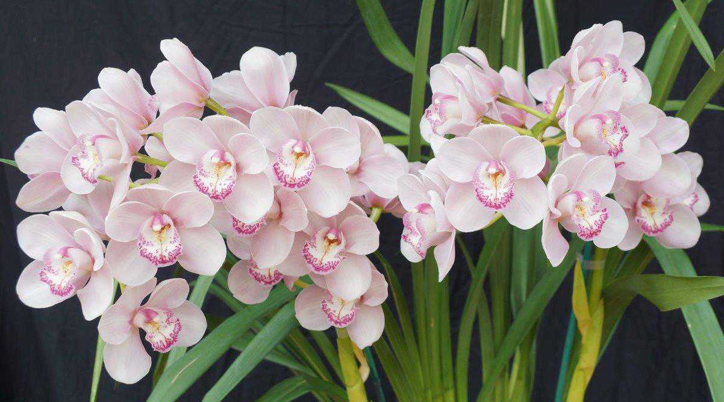
Cymbidium Laramie Eagle ‘Pink’
Terry Poulton

Slide 49
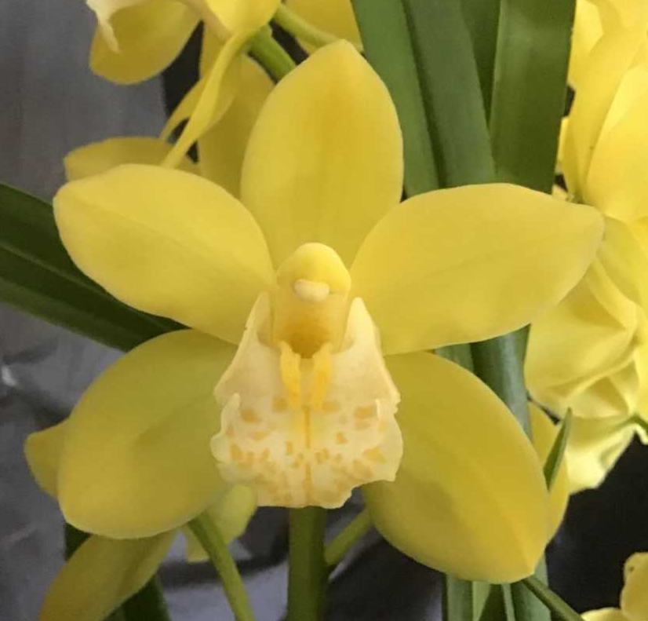
Cymbidium Dolly-Lin ‘Golden Beauty’
M. Owens
HCC/OSCOV
75.8

Slide 50
Cymbidium Kimberley Lagoon ‘Paul’
Paul Latina
HCC/OSCOV
76.1

Slide 51
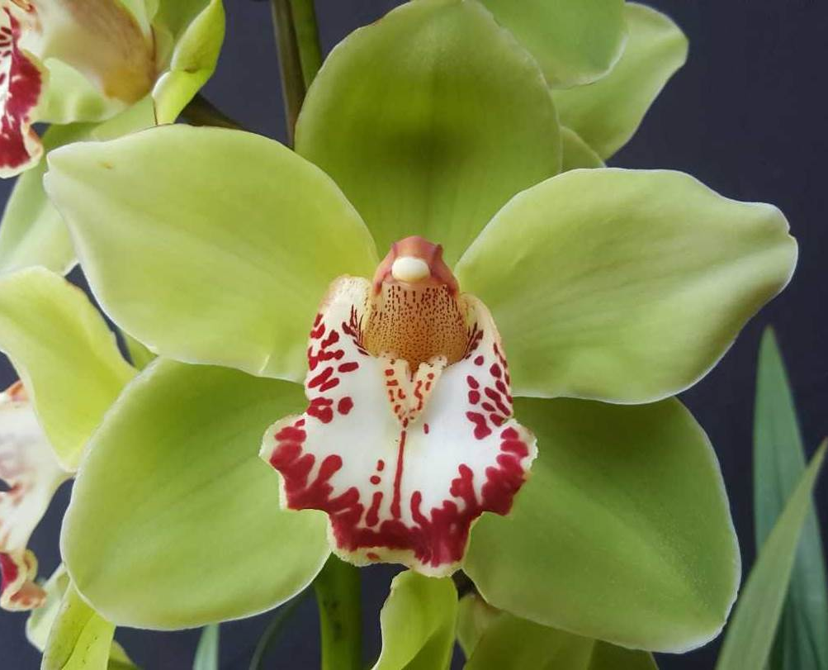

Slide 52
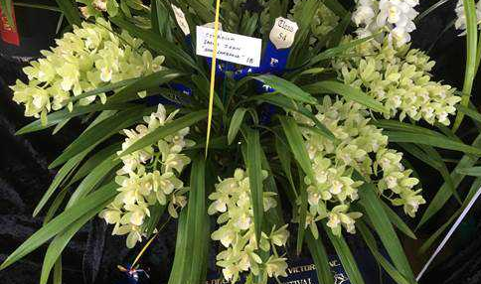
Cymbidium Sarah Jean ‘Ena Langdale’
N. Blamey
HCC/OSCOV
77.0

Slide 53
Cymbidium Kimberley Jungle ‘Kimberley’
J. Robertson
HCC/OSCOV
77.0

Slide 54
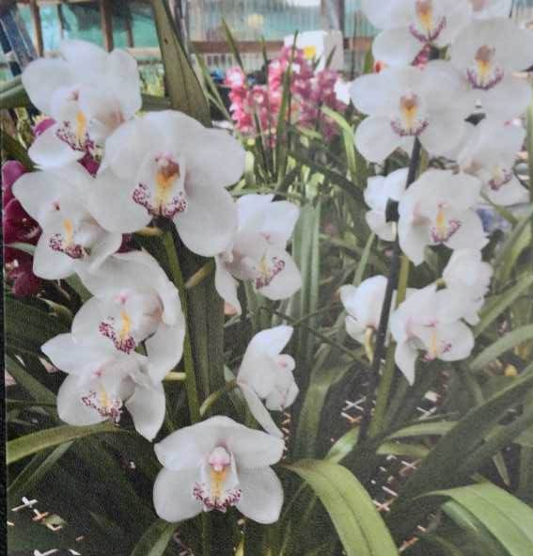
Cymbidium Blushing ‘Hazlewood’
K. Wilson
HCC/OSCOV
76.0

Slide 55
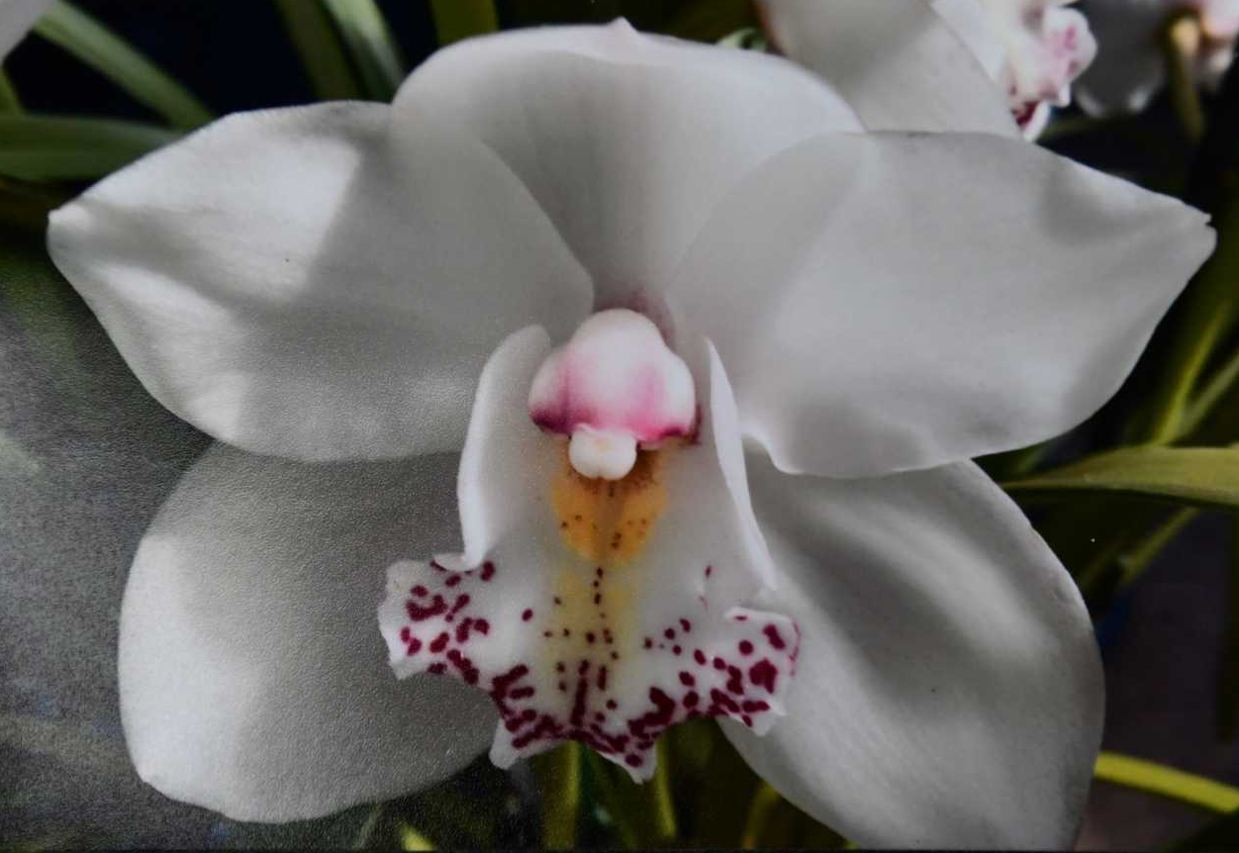

Slide 56
AND THE WINNER IS . . .

Slide 57
Cymbidium Laramie Eagle ‘Pink’
Terry Poulton

Slide 58
Laeliinae hybrid ORCHID
Sponsored by
Mid-Murray Orchid Society

Slide 59
AND THE WINNER IS . . .

Slide 60
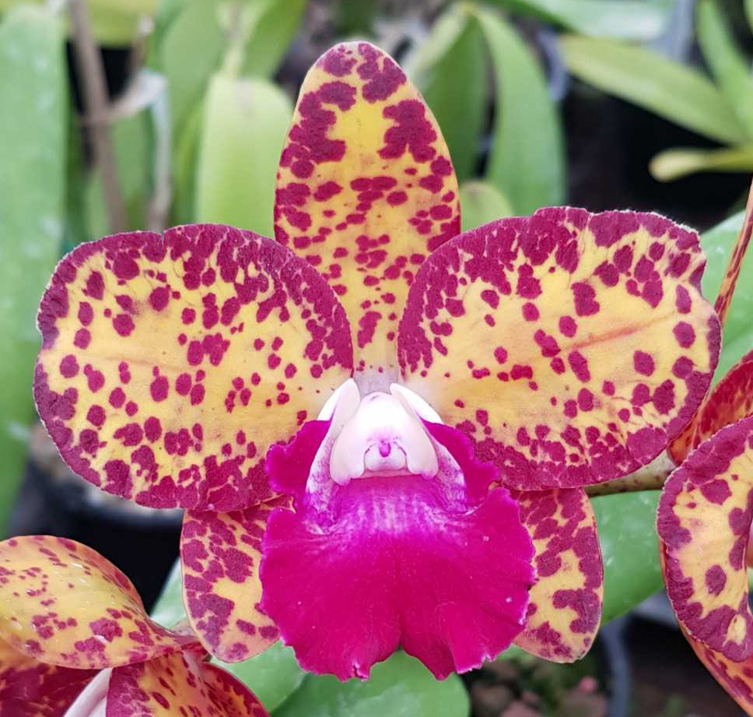
Cattleya Nikki ‘Precious Spots’
Michael Murray
HCC/OSCOV
78.0

Slide 61
Masdevallia hybrid ORCHID
Sponsored by
Warrnambool & District Orchid Society

Slide 62
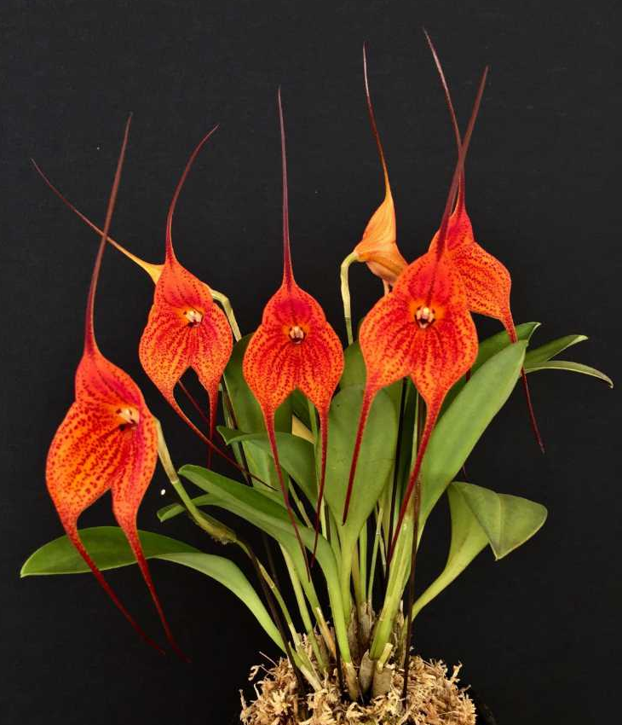
Masdevallia Super Nova ‘Starship’
Clive & Agi Halls
AM/OSCOV
80.4

Slide 63
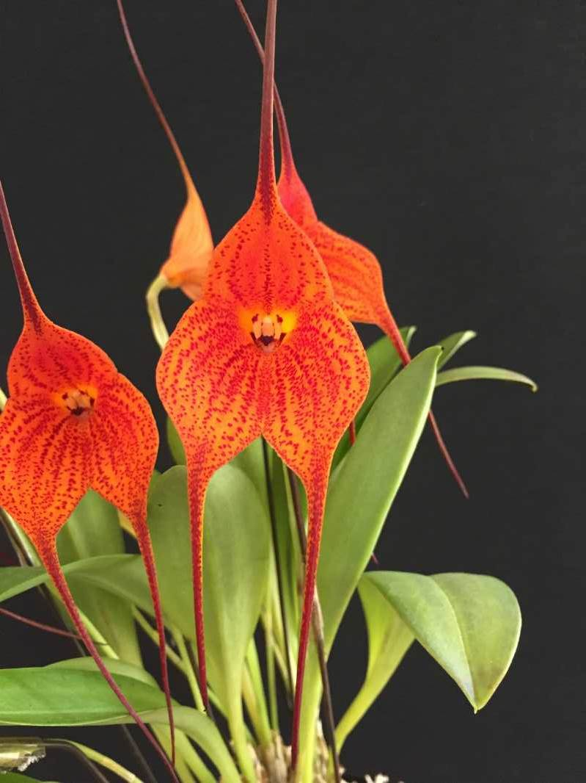

Slide 64
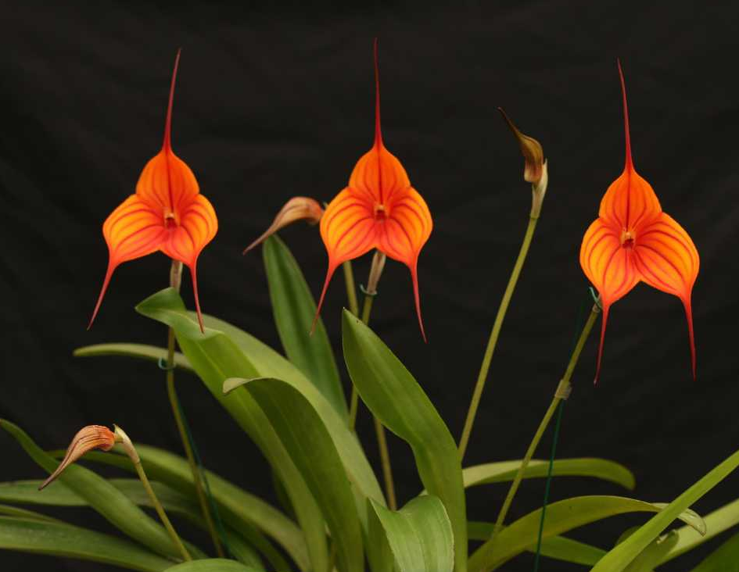
Masdevallia Stripe King ‘Sparkle’
Marita Anderson
’
AM/OSCOV
81.3

Slide 66
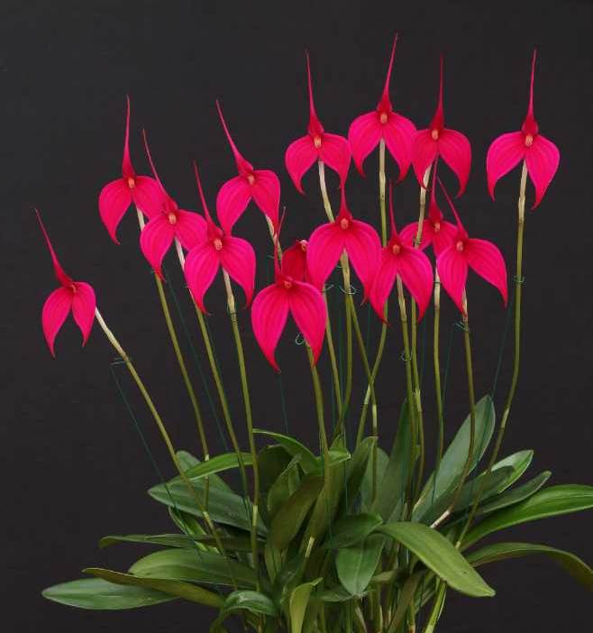
Masdevallia Rubicon ‘Storm’
Marita Anderson
AM/OSCOV
82.0
Notes:
66

Slide 67
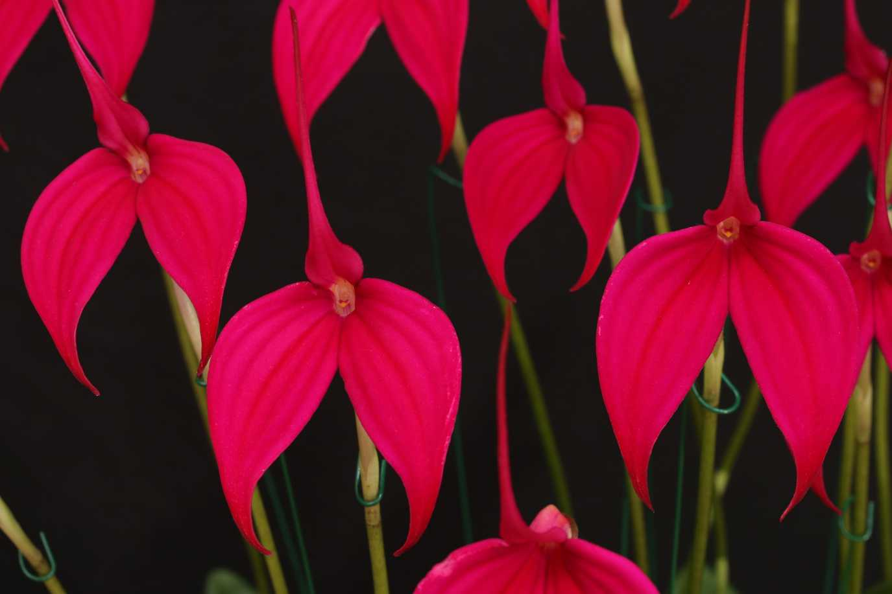

Slide 68
AND THE WINNER IS . . .

Slide 69
Masdevallia Stripe King ‘Sparkle’
Marita Anderson
’

Slide 70
oncidiinae hybrid ORCHID
Sponsored by
Bendigo Orchid Club

Slide 71
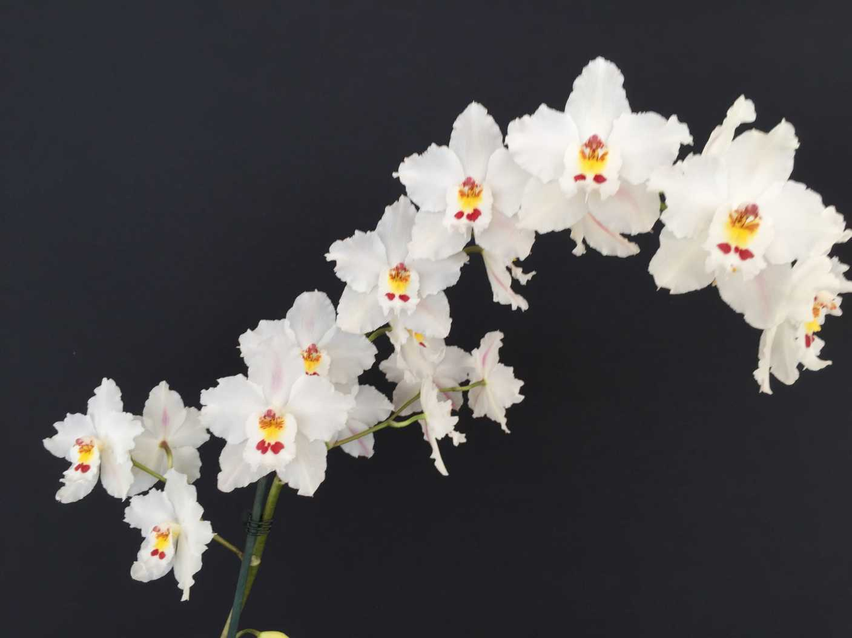
Oncidium Donna Buang ‘Beenak’
Clive & Agi Halls
HCC/OSCOV
78.0

Slide 72
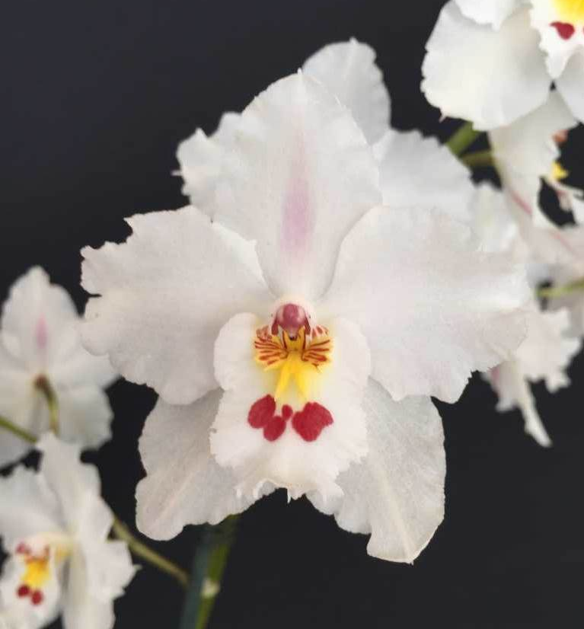

Slide 73
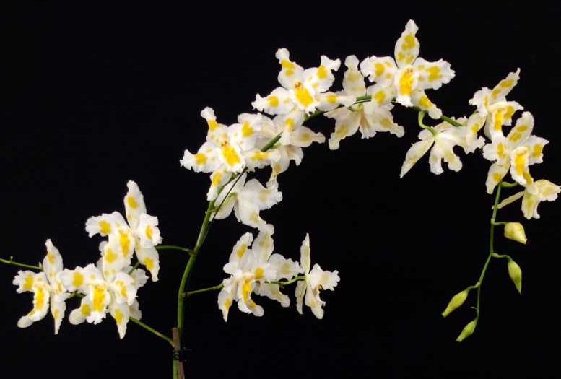
Oncidium Snowfall ‘Beenak’
Clive & Agi Halls
HCC/OSCOV
79.5

Slide 75
AND THE WINNER IS . . .

Slide 76
Oncidium Donna Buang ‘Beenak’
Clive & Agi Halls

Slide 77
paphiopedilum species ORCHID
Sponsored by
Stawell Orchid Society

Slide 78
Paphiopedilum hangianum ‘Julian’
Michael Coker

Slide 80
Paphiopedilum leucochilum ‘Alina’
Konrad Potocki
HCC/OSCOV
78.6

Slide 81
Paphiopedilum micranthum ‘Sashkia’
T. Visser
AM/OSCOV
81.6

Slide 83
Paphiopedilum micranthum f. eburneum ‘Distinction’
Craig & Fiona Miles
HCC/OSCOV
78.5

Slide 85
Paphiopedilum sukhakulii ‘Dark Leopard’
Michael Coker
AM/OSCOV
80.0

Slide 87
Paphiopedilum sukhakulii ‘Spotted Leopard’
Michael Coker
HCC/OSCOV
79.9

Slide 89
Paphiopedilum hookerae ‘Distinction’
Craig & Fiona Miles
HCC/OSCOV
79.7

Slide 91
AND THE WINNER IS . . .

Slide 92
Paphiopedilum hookerae ‘Distinction’
Craig & Fiona Miles

Slide 93
paphiopedilum hybrid ORCHID
Sponsored by
Ballarat Orchid Society

Slide 94
Paphiopedilum Dark Knight ‘Julian’ Michael Coker
HCC/OSCOV
79.9

Slide 96
Paphiopedilum Stone Galaxy ‘Constellation’
Michael Coker
AM/OSCOV
81.4

Slide 98
Paphiopedilum Saint Swithin ‘Scorpio’
Craig & Fiona Miles
AM/OSCOV
80.6

Slide 100
Paphiopedilum Spellbound ‘Ballarat’
Craig & Fiona Miles
AM/OSCOV
81.1

Slide 102
Paphiopedilum Hung Sheng Vanilla ‘Dark Sugar’
V. & A. Helbig
HCC/OSCOV
76.1

Slide 103
Paphiopedilum Peppercorn ‘Alexandra’
Michael Coker
HCC/OSCOV
76.9

Slide 105
Paphiopedilum Norito Hasegawa ‘Julian’
Michael Coker
AM/OSCOV
80.0

Slide 107
AND THE WINNER IS . . .

Slide 108
Paphiopedilum Peppercorn ‘Alexandra’
Michael Coker

Slide 109
Any other hybrid ORCHID
Sponsored by
North-East Melbourne Orchid Society

Slide 110
Phragmipedium Nitidissimum ‘Rayber’
Cory Haugh
HCC/OSCOV
79.3

Slide 112
Dendrobium Australian Ginger ‘Dimos’
M. Morgan
HCC/OSCOV
75.5

Slide 114
Angraecum Mem. Mark Aldridge ‘Madison’
Gabor & Julianna Szep
HCC/OSCOV
79.7

Slide 116
Phragmipedium Early Surprise ‘Sophie’
Stephen & Meryl Early
HCC/OSCOV
78.0

Slide 118
Clowesetum Brown’s Delight ‘Margaret’
Stephen & Meryl Early
HCC/OSCOV
79.0

Slide 120
Pleione Izalko ‘Archie’
Archie Leenen
HCC/OSCOV
78.4

Slide 122
AND THE WINNER IS . . .

Slide 123
Angraecum Mem. Mark Aldridge ‘Madison’
Gabor & Julianna Szep

Slide 124
Any other species ORCHID
Sponsored by The Orchid Species Society of Victoria

Slide 125
Sudamerlycaste dyeriana ‘Green Magic’
Dieter Weise
AM/OSCOV
80.2

Slide 127
Huntleya meleagris ‘Alexandra’
Michael Coker
HCC/OSCOV
75.7

Slide 129
Paphinia herrerae ‘Jurassic’
Michael Coker
HCC/OSCOV
76.4

Slide 131
Cattleya intermedia f. alba ‘Snow White’
Alex & Bev Mentiplay
HCC/OSCOV
76.8

Slide 133
Cymbidium tigrinum ‘Tigress’
Dieter Weise
HCC/OSCOV
76.3

Slide 135
AND THE WINNER IS . . .

Slide 136
Sudamerlycaste dyeriana ‘Green Magic’
Dieter Weise

Slide 137
Harold & Florence Coker Memorial Trophy SEEDLING ORCHID
Sponsored by
Julian & Frances Coker

Slide 138
Sarcochilus Moonglow ‘Luxury’
Glenice Simmons
Notes:
138

Slide 139
Paphiopedilum hangianum ‘Julian’
Michael Coker

Slide 140
Paphiopedilum Dark Knight ‘Julian’ Michael Coker

Slide 141
Paphiopedilum leucochilum ‘Alina’
Konrad Potocki

Slide 142
Phragmipedium Nitidissimum ‘Rayber’
Cory Haugh

Slide 143
Paphiopedilum Stone Galaxy ‘Constellation’
Michael Coker

Slide 144
Huntleya meleagris ‘Alexandra’
Michael Coker

Slide 145
Oncidium Donna Buang ‘Beenak’
Clive & Agi Halls

Slide 146
Paphiopedilum micranthum ‘Sashkia’
T. Visser

Slide 147
Oncidium Snowfall ‘Beenak’
Clive & Agi Halls

Slide 148
Sarcochilus Glenda ‘Beenak’
Clive & Agi Halls

Slide 149
Dendrobium Brimbank Mikado ‘RACB’
Robin Bavinton

Slide 150
Dendrobium Currajung ‘RACB’
Robin Bavinton

Slide 151
Paphiopedilum Hung Sheng Vanilla ‘Dark Sugar’
V. & A. Helbig

Slide 152
Paphiopedilum sukhakulii ‘Spotted Leopard’
Michael Coker

Slide 153
Paphiopedilum hookerae ‘Distinction’
Craig & Fiona Miles

Slide 154
Cymbidium Kimberley Jungle ‘Kimberley’
J. Robertson

Slide 155
Cymbidium Blushing ‘Hazlewood’
K. Wilson

Slide 156
AND THE WINNER IS . . .

Slide 157
Paphiopedilum hookerae ‘Distinction’
Craig & Fiona Miles

Slide 158
Award of quality
Sponsored by Ringwood Orchid Society

Slide 159
Sarcochilus Glenda
Clive & Agi Halls
HCC/OSCOV

Slide 160
Paphiopedilum Stone Galaxy
Michael Coker
AM/OSCOV
HCC/OSCOV

Slide 161
AND THE WINNER IS . . .

Slide 162
Paphiopedilum Stone Galaxy
Michael Coker

Slide 163
Best cultured hybrid ORCHID
Sponsored by Berwick Orchid Society

Slide 164
Cymbidium Laramie Gold ‘Golden Anniversary’
Terry Poulton

Slide 165
Paphiopedilum Saint Swithin ‘Julian’
Michael Coker
CC/OSCOV

Slide 167
Angraecum Mem. Mark Aldridge ‘Madison’
Gabor & Julianna Szep
CC/OSCOV

Slide 168
Sarcochilus Weinhart ‘Magic Wein’
V. & A. Helbig
CC/OSCOV

Slide 169
Laeliocattleya Santa Barbara Sunset ‘Devon’
Colin & Karen Gillespie
CC/OSCOV

Slide 170
Cymbidium Sarah Jean ‘Ena Langdale’
N. Blamey
CC/OSCOV

Slide 171
Cymbidium Devon Odyssey ‘Wendy’
Colin & Karen Gillespie
CC/OSCOV

Slide 172
Masdevallia Kimballiana ‘Yellow Doll’
Marita Anderson
CC/OSCOV

Slide 173
Dendrobium Tania ‘Stars’
Jeanne Dunn
CC/OSCOV

Slide 174
Masdevallia Rubicon ‘Storm’
Marita Anderson
CC/OSCOV
Notes:
174

Slide 175
AND THE WINNER IS . . .

Slide 176
Paphiopedilum Saint Swithin ‘Julian’
Michael Coker

Slide 177
Best cultured species ORCHID
Sponsored by Maroondah Orchid Society

Slide 178
Sudamerlycaste dyeriana ‘Green Magic’
Dieter Weise
CC/OSCOV

Slide 179
Oncidium sotoanum ‘Sarah D’
Elena & Terry Stiles
CC/OSCOV

Slide 181
Dendrobium tetragonum ‘St. Austel’
Marilyn & Barry Larkin
CC/OSCOV

Slide 182
Diuris orientis ‘Langwarrin’
Alan Rogers
CC/OSCOV

Slide 184
Cymbidium tigrinum ‘Tigress’
Dieter Weise
CC/OSCOV

Slide 185
Dendrobium striolatum ‘Magic’
Murray Harding & Di Lester
CC/OSCOV
Notes:
185

Slide 186
AND THE WINNER IS . . .

Slide 187
Sudamerlycaste dyeriana ‘Green Magic’
Dieter Weise

Slide 188
Memoria Gunter Haar best cultured ORCHID
Sponsored by
OSCOV

Slide 189
Paphiopedilum Saint Swithin ‘Julian’
Michael Coker
Sudamerlycaste dyeriana ‘Green Magic’
Dieter Weise

Slide 190
AND THE WINNER IS . . .

Slide 191
Paphiopedilum Saint Swithin ‘Julian’
Michael Coker

Slide 192
And The 11 finalists for the 2019 vooty are . . .

Slide 193
Australian Native Hybrid #1
Australian Native Hybrid #2
Australian Native Species
Cymbidium Hybrid
Laeliinae Hybrid
Masdevallia Hybrid

Slide 194
Oncidiinae Hybrid
Paphiopedilum Hybrid
Paphiopedilum Species
Any Other Hybrid
Any Other Species

Slide 195
AND THE VOOTY 2019 WINNER IS . . .

Slide 196
Paphiopedilum Peppercorn ‘Alexandra’
Michael Coker

Slide 197
The End !

